Slide 1
Networking
400IT – W1-S2

Slide 2
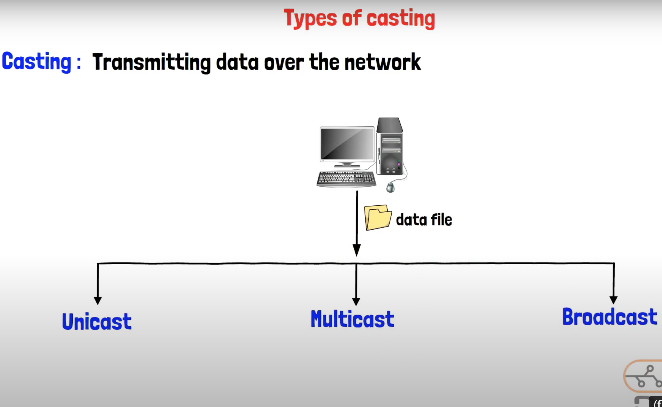
Types of casting

Slide 3
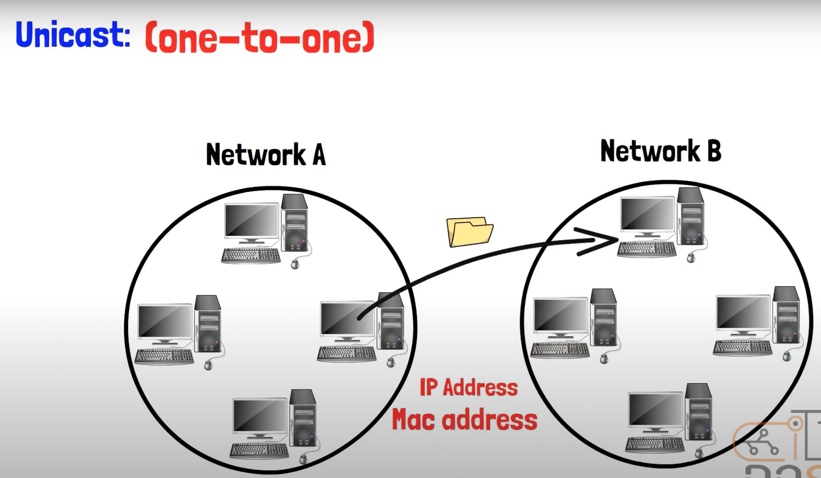
Types of casting
Unicast: Data is sent from one device to another specific device.

Slide 4
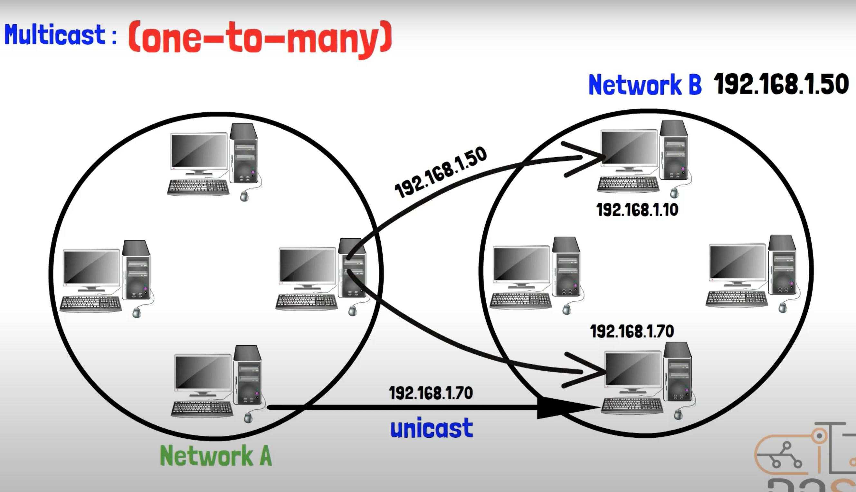
Types of casting
Multicast: Data is sent from one device to a specific group of devices that have subscribed to receive it.

Slide 5

Types of casting
Multicast Example

Slide 6
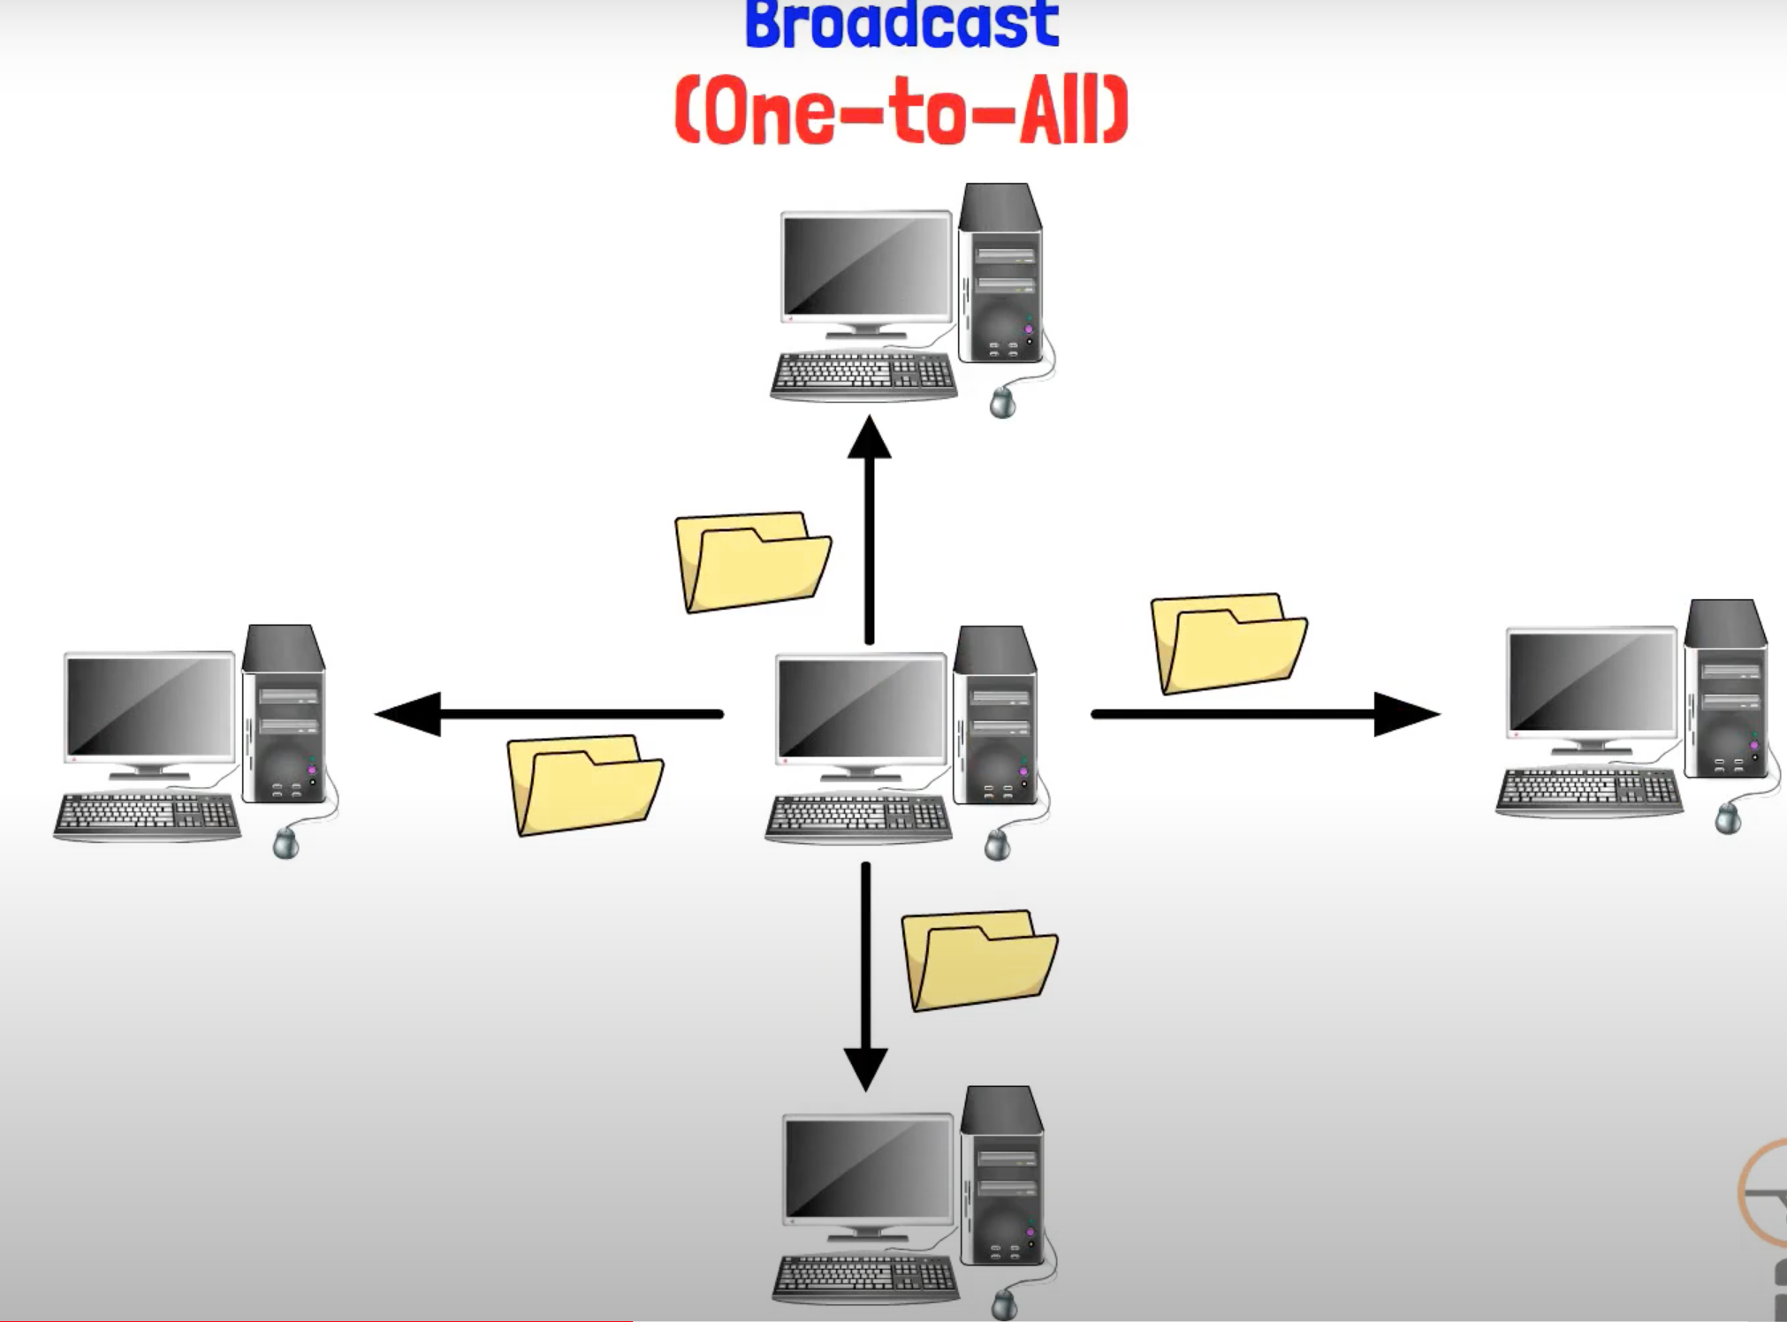
Types of casting
Broadcast: Data is sent from one device to all devices on the network.

Slide 7
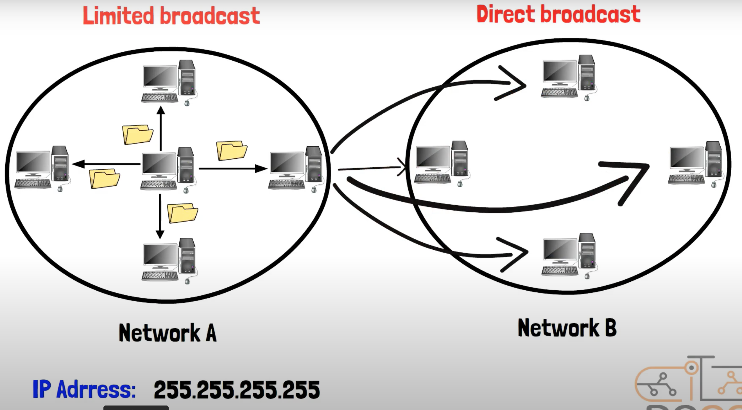
Types of casting

Slide 8
Types of casting

Slide 9
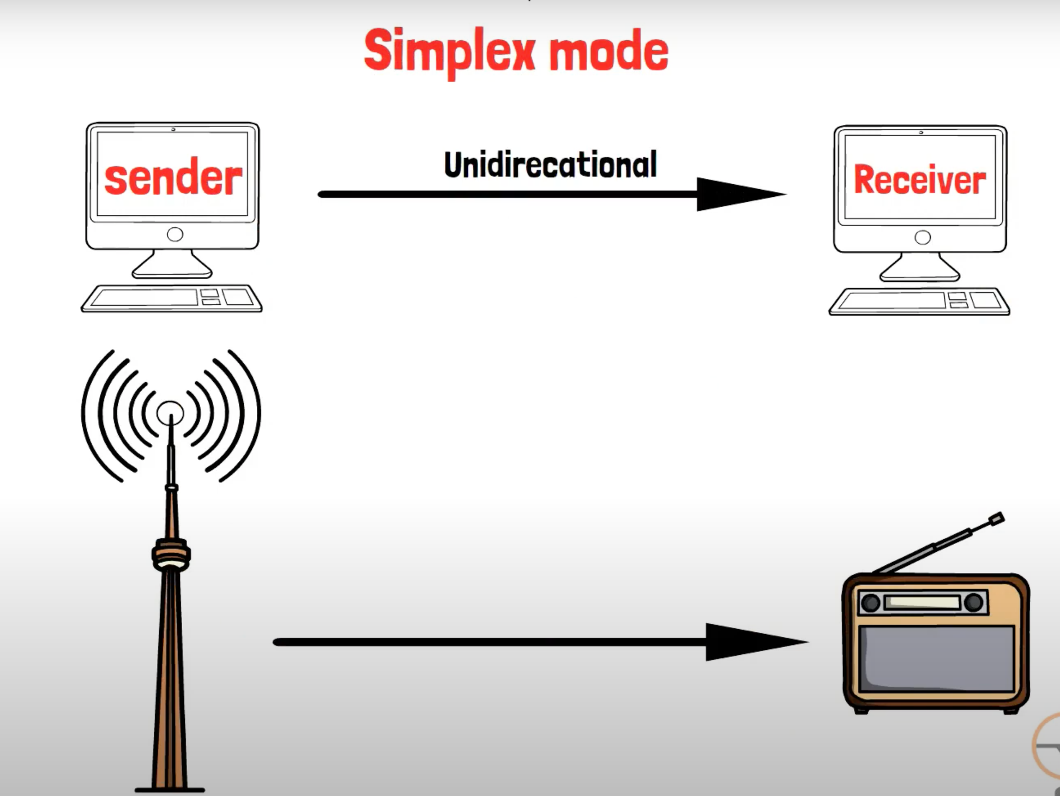
Types of Transmission Modes
Simplex: Data flows in one direction only, from sender to receiver.

Slide 10
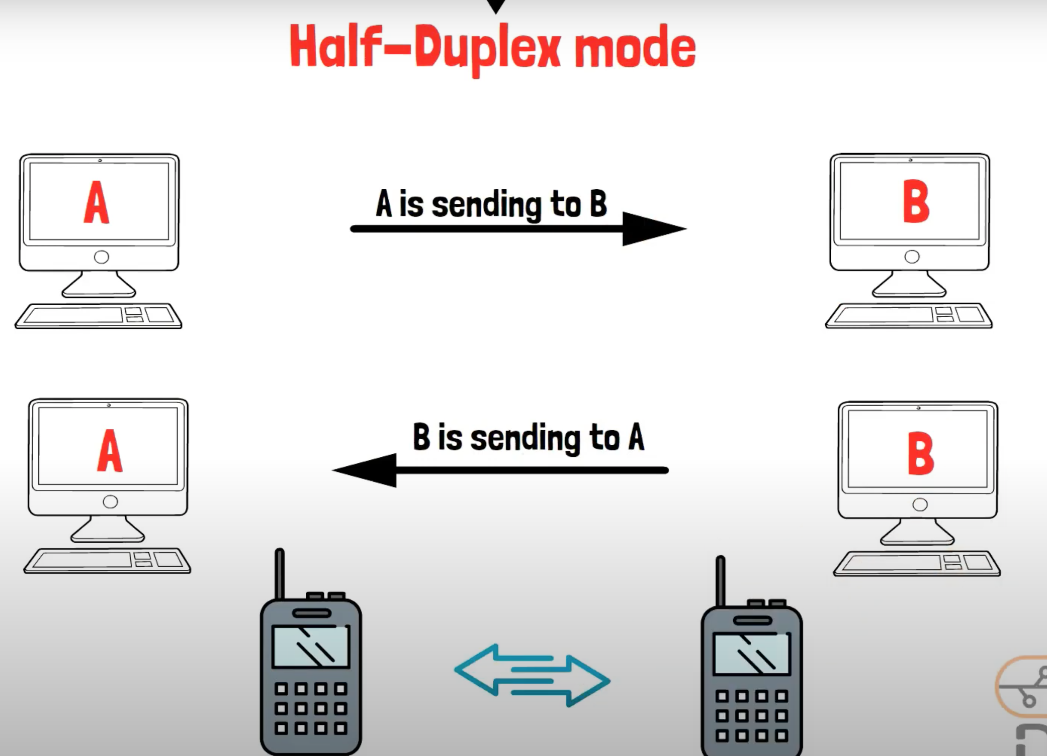
Types of casting
Half-duplex: Data can be transmitted in both directions, but not simultaneously.

Slide 11
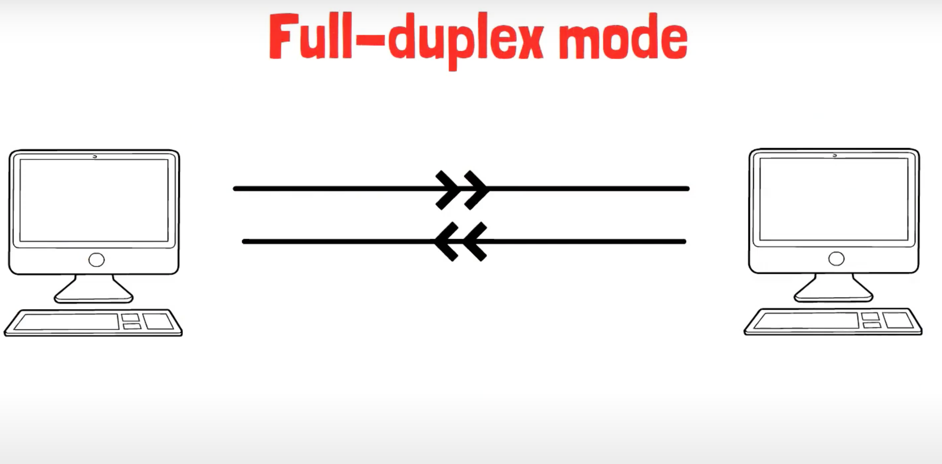
Types of casting
Full-duplex: Data can be transmitted simultaneously in both directions.

Slide 12
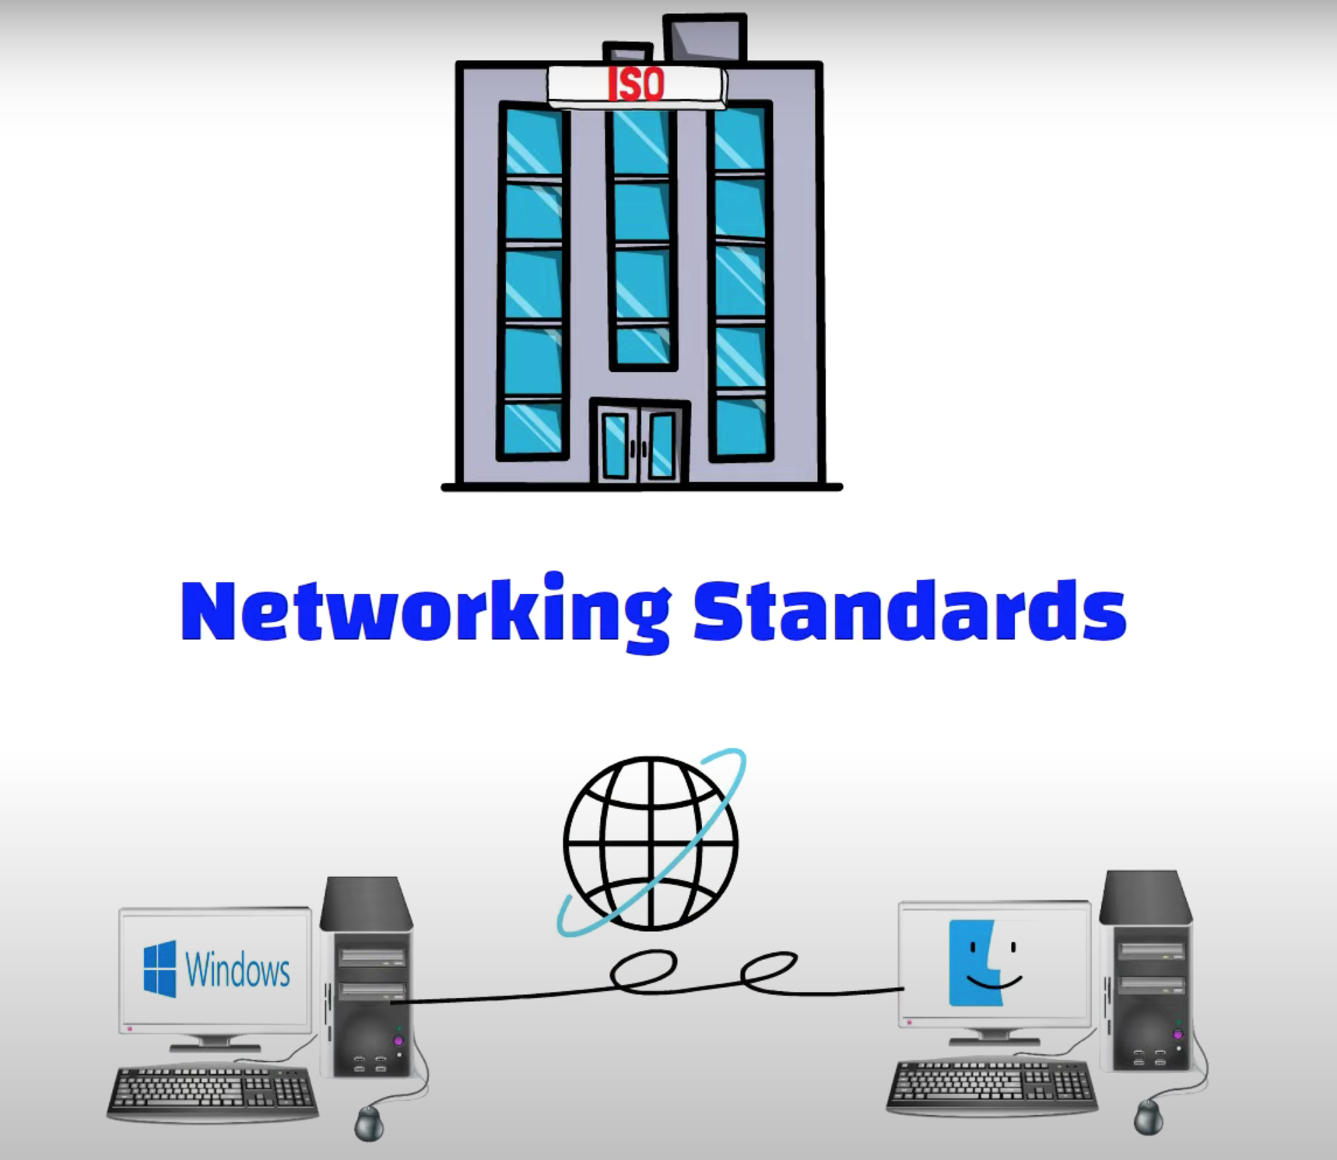
Standards
Standards are sets of rules that ensure hardware and software released from different companies work together

Slide 13
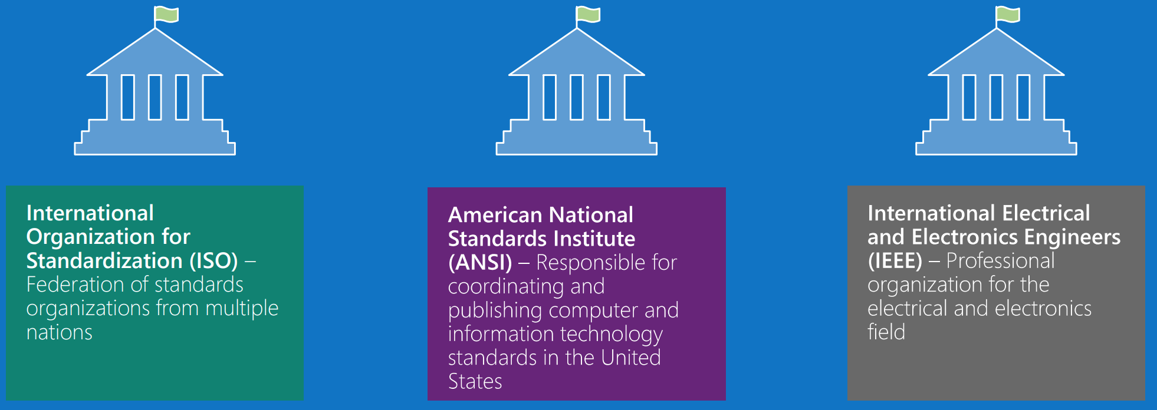
Standards
Examples of Organizations that Coordinate Standards:

Slide 14
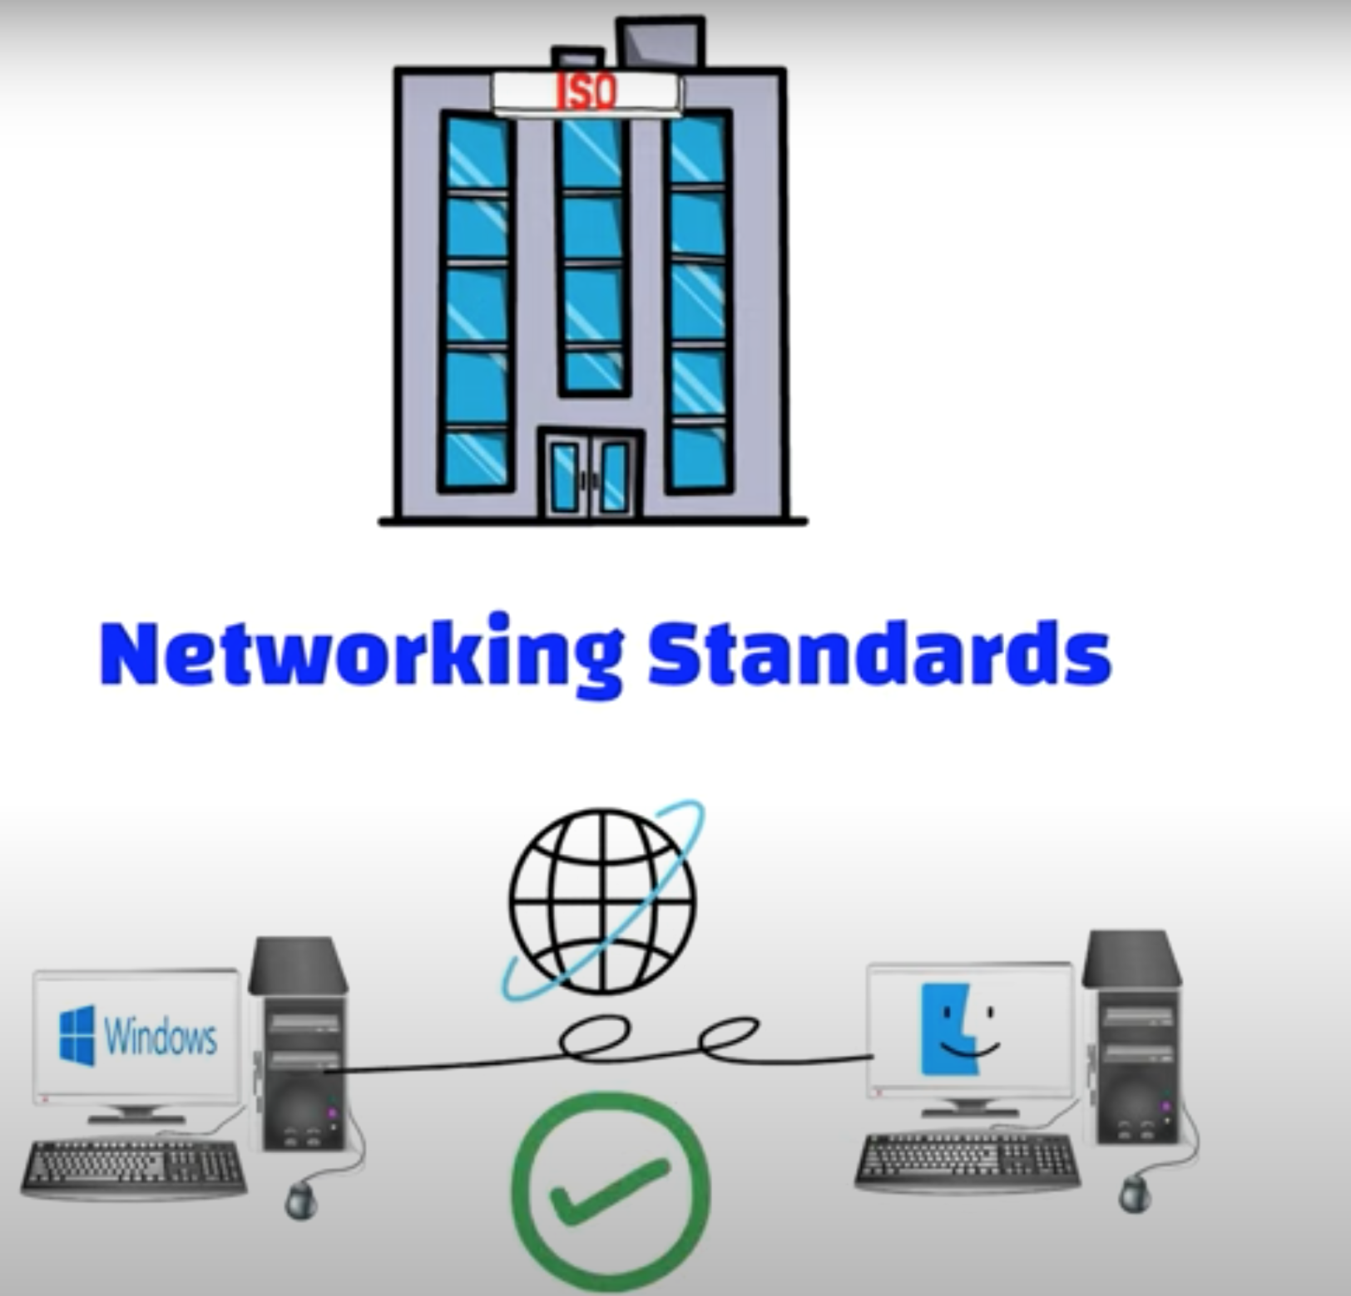
Standards
Examples of Organizations that Coordinate Standards:

Slide 15
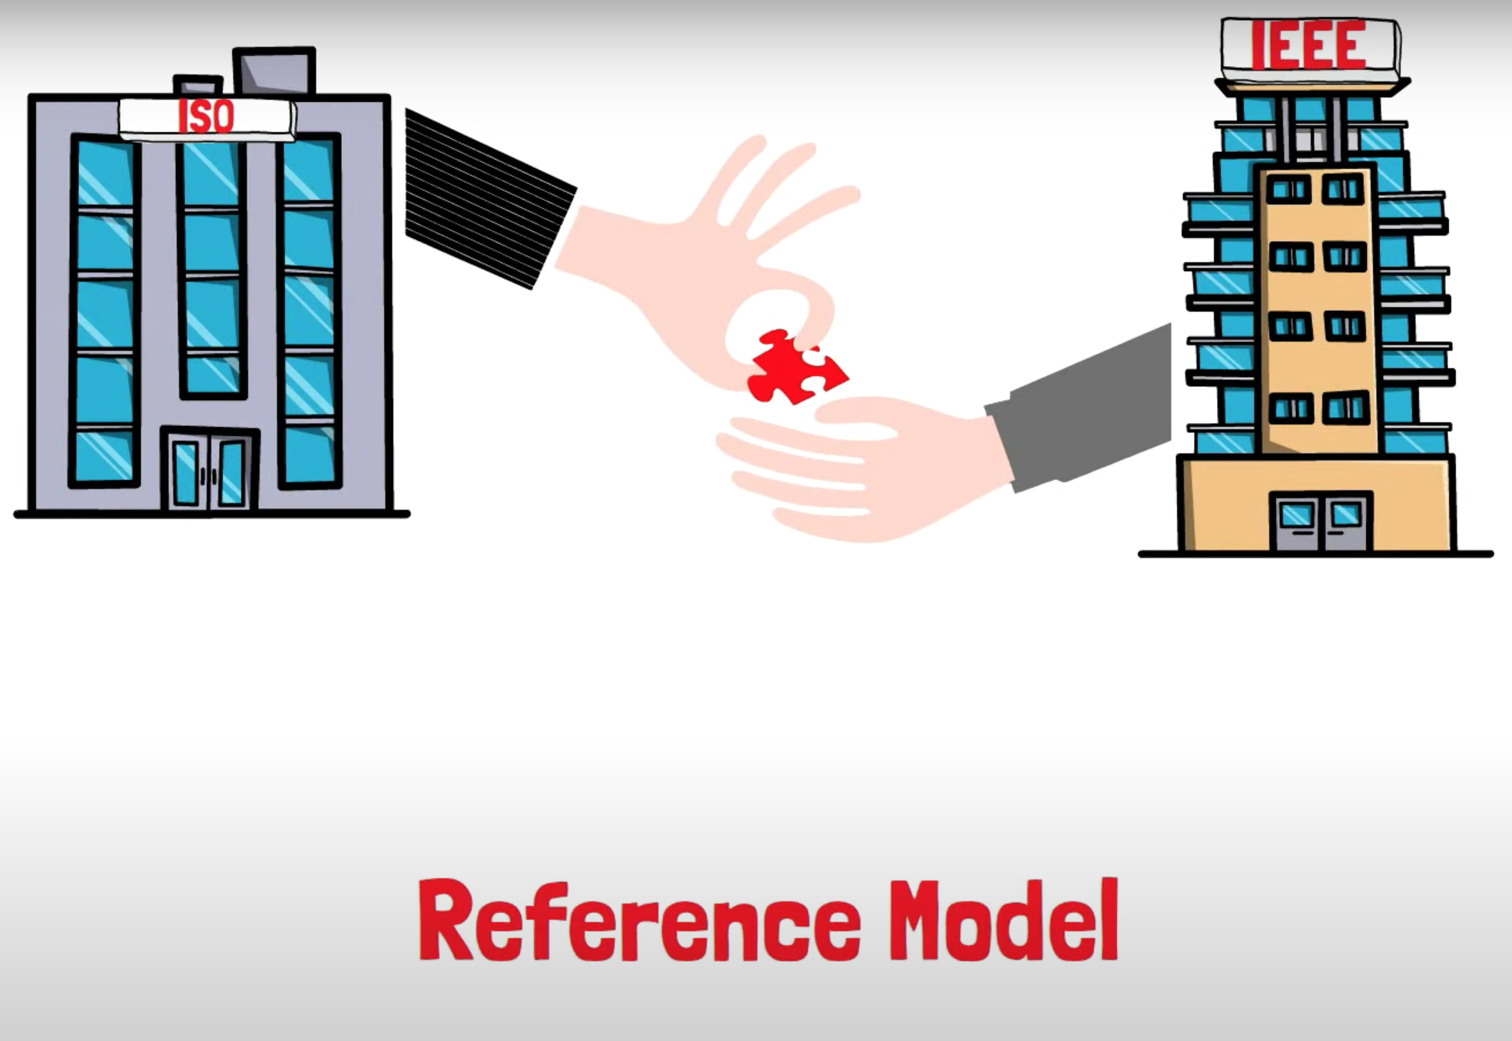
Standards
Examples of Organizations that Coordinate Standards:

Slide 16
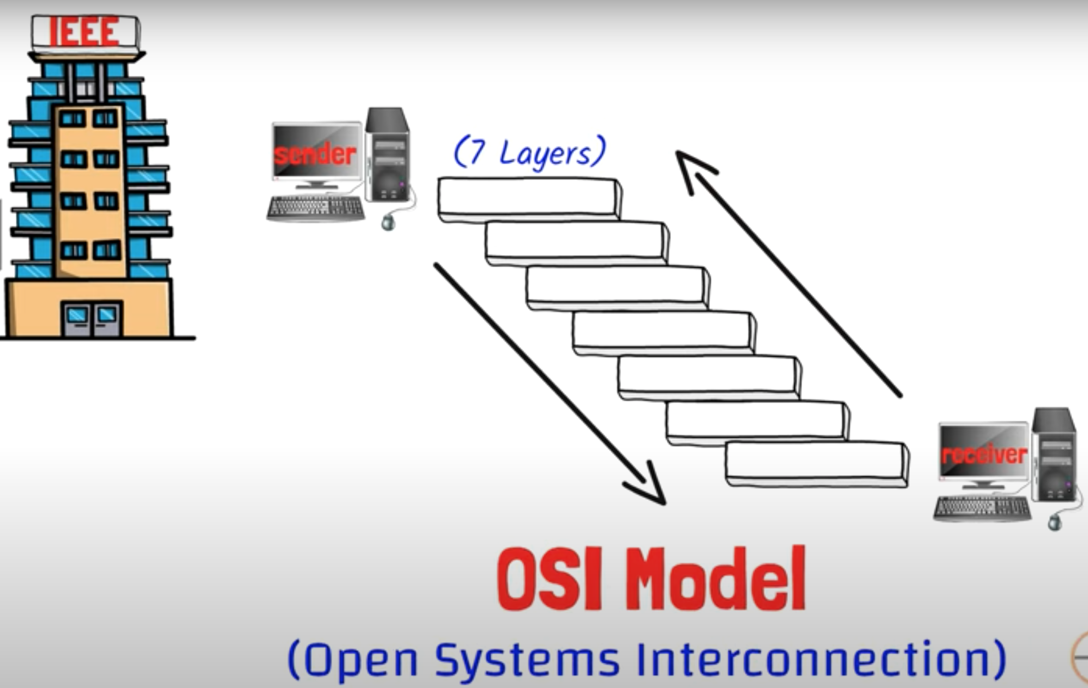
Open Systems Interconnection (OSI)

Slide 17
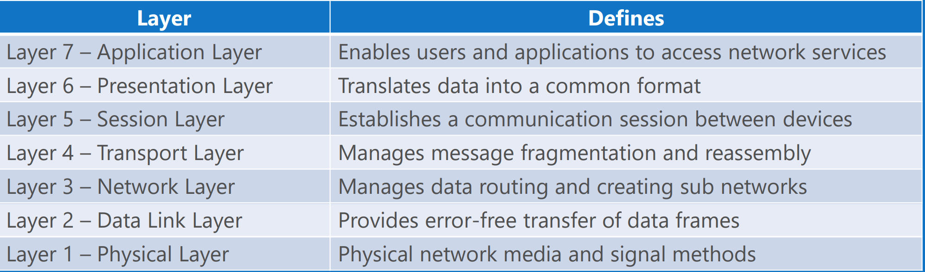
Open Systems Interconnection (OSI)
The Open Systems Interconnection (OSI) reference model is used to define how data communication occurs between devices.
The model is divided into 7 layers, each layer providing services to the layers above and below

Slide 18
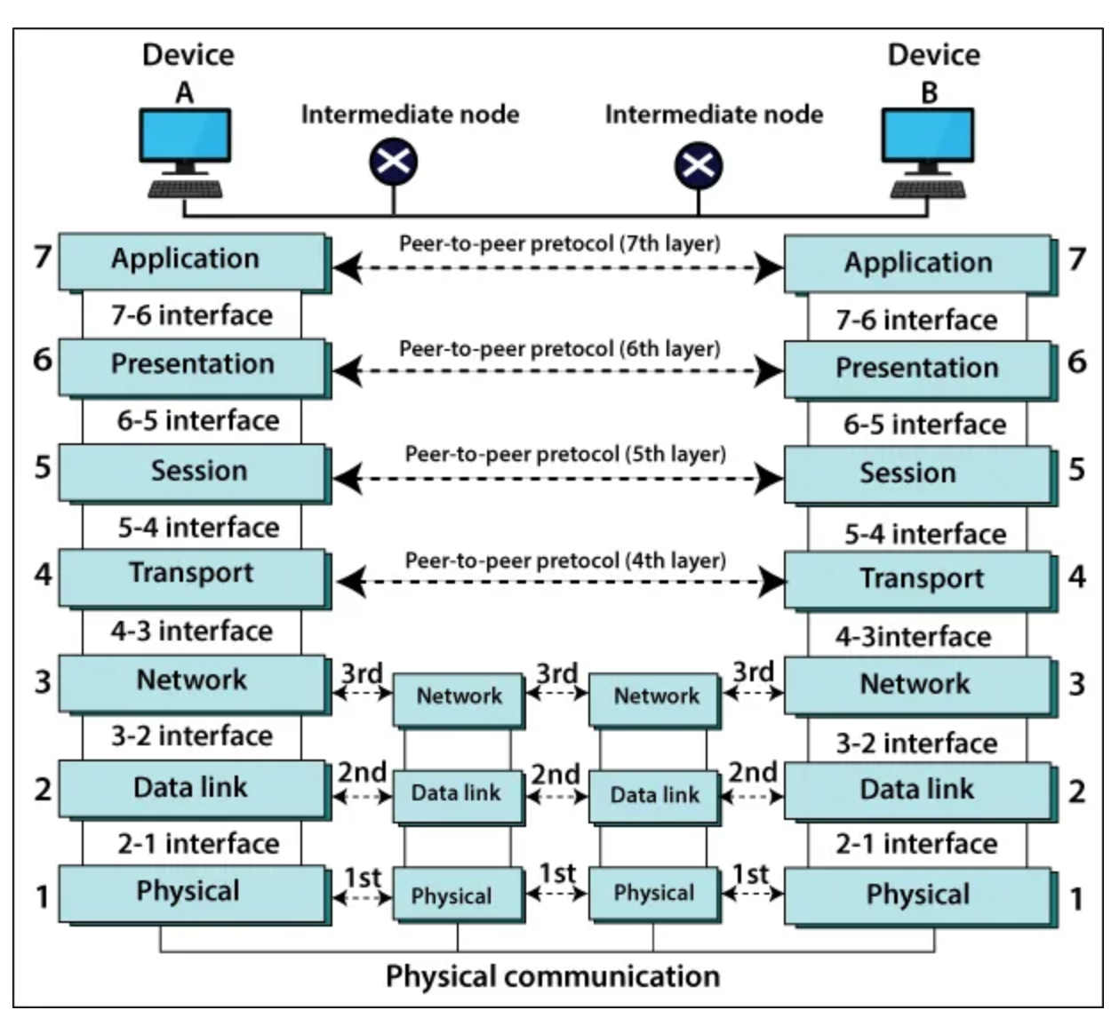
Open Systems Interconnection (OSI)
The model is divided into 7 layers, each layer providing services to the layers above and below

Slide 19
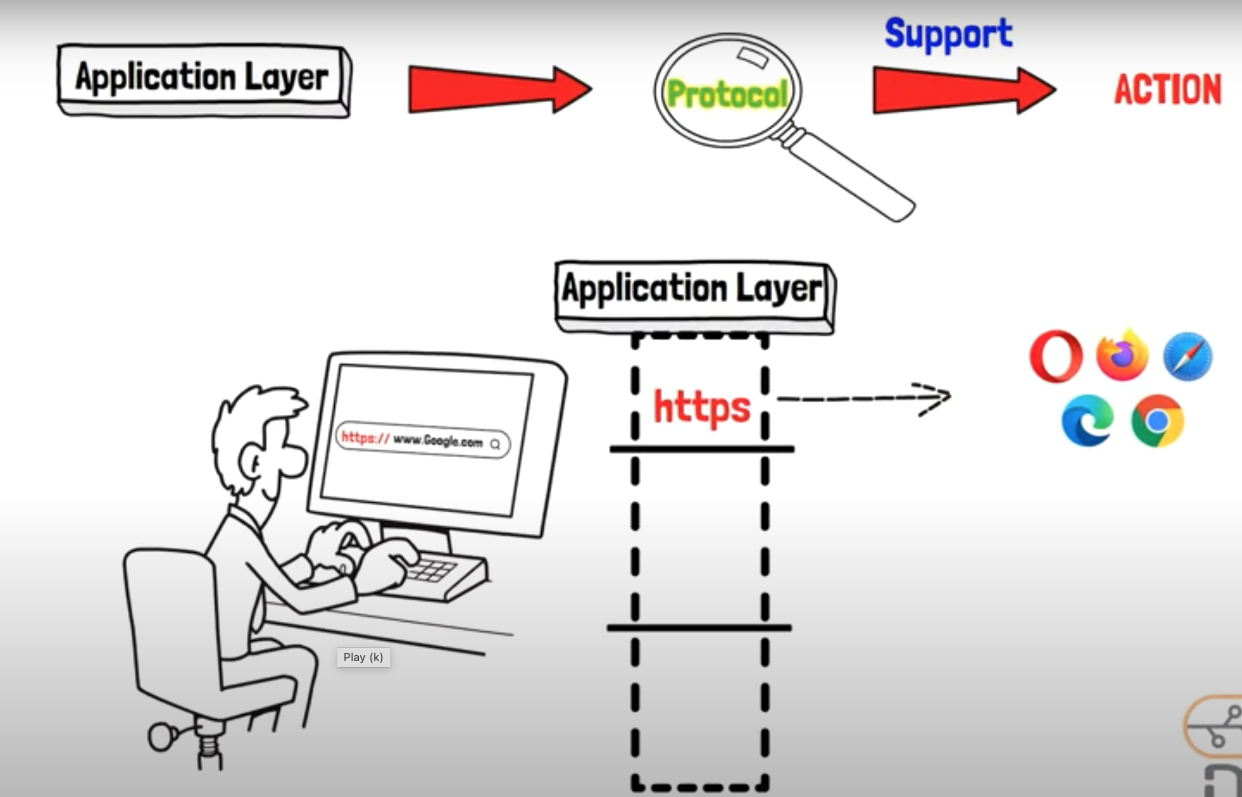
Layer 7 – Application Layer

Slide 20
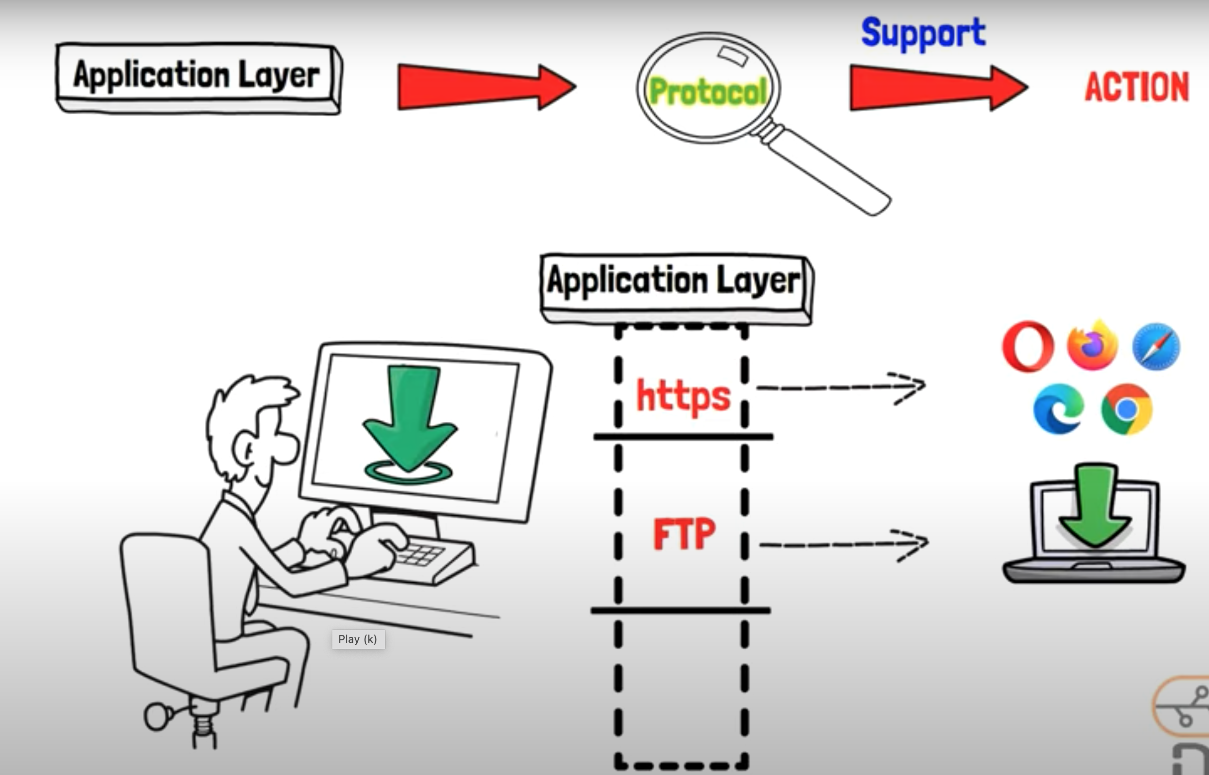
Layer 7 – Application Layer

Slide 21
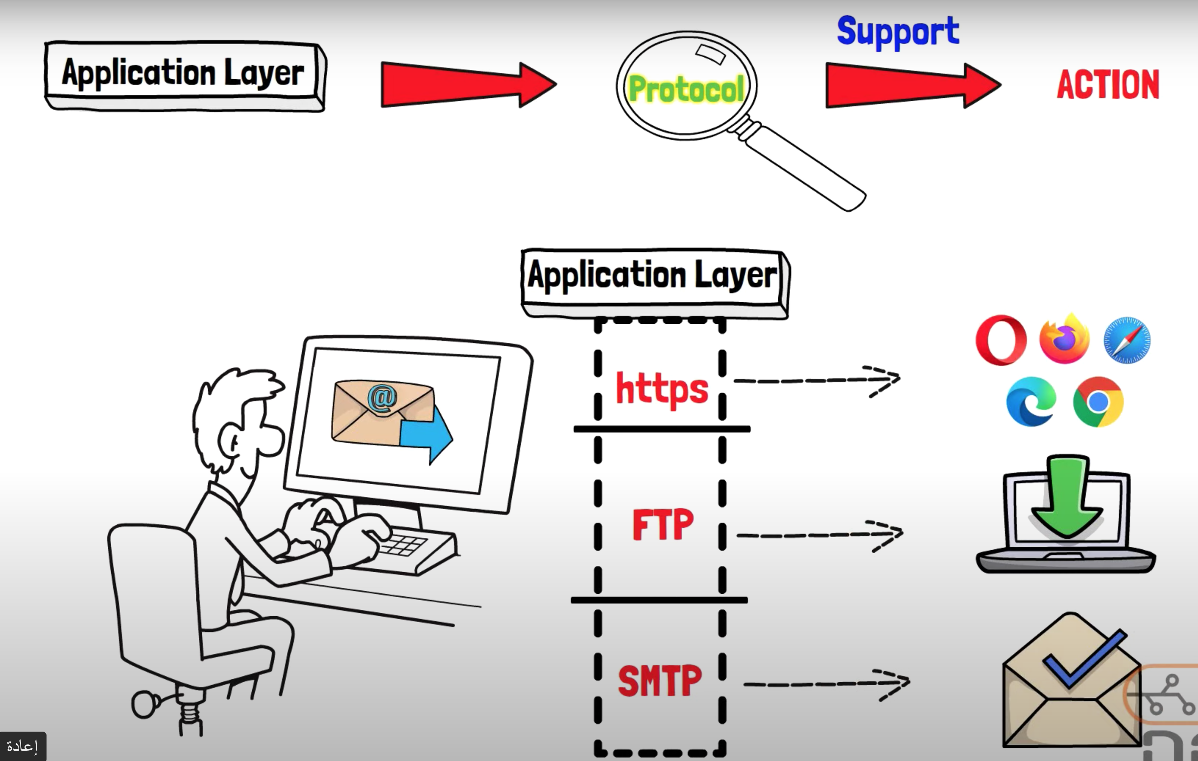
Layer 7 – Application Layer

Slide 22
Layer 7 – Application Layer
The application layer is used by end-user software such as web browsers and email clients.
It provides protocols that allow software to send and receive information and present meaningful data to users..
This layer is where message creation begins.
End-user protocols such as FTP, SMTP, Telnet, and RAS work at this layer.
This layer is not the application itself, but the protocols that are initiated by this layer

Slide 23
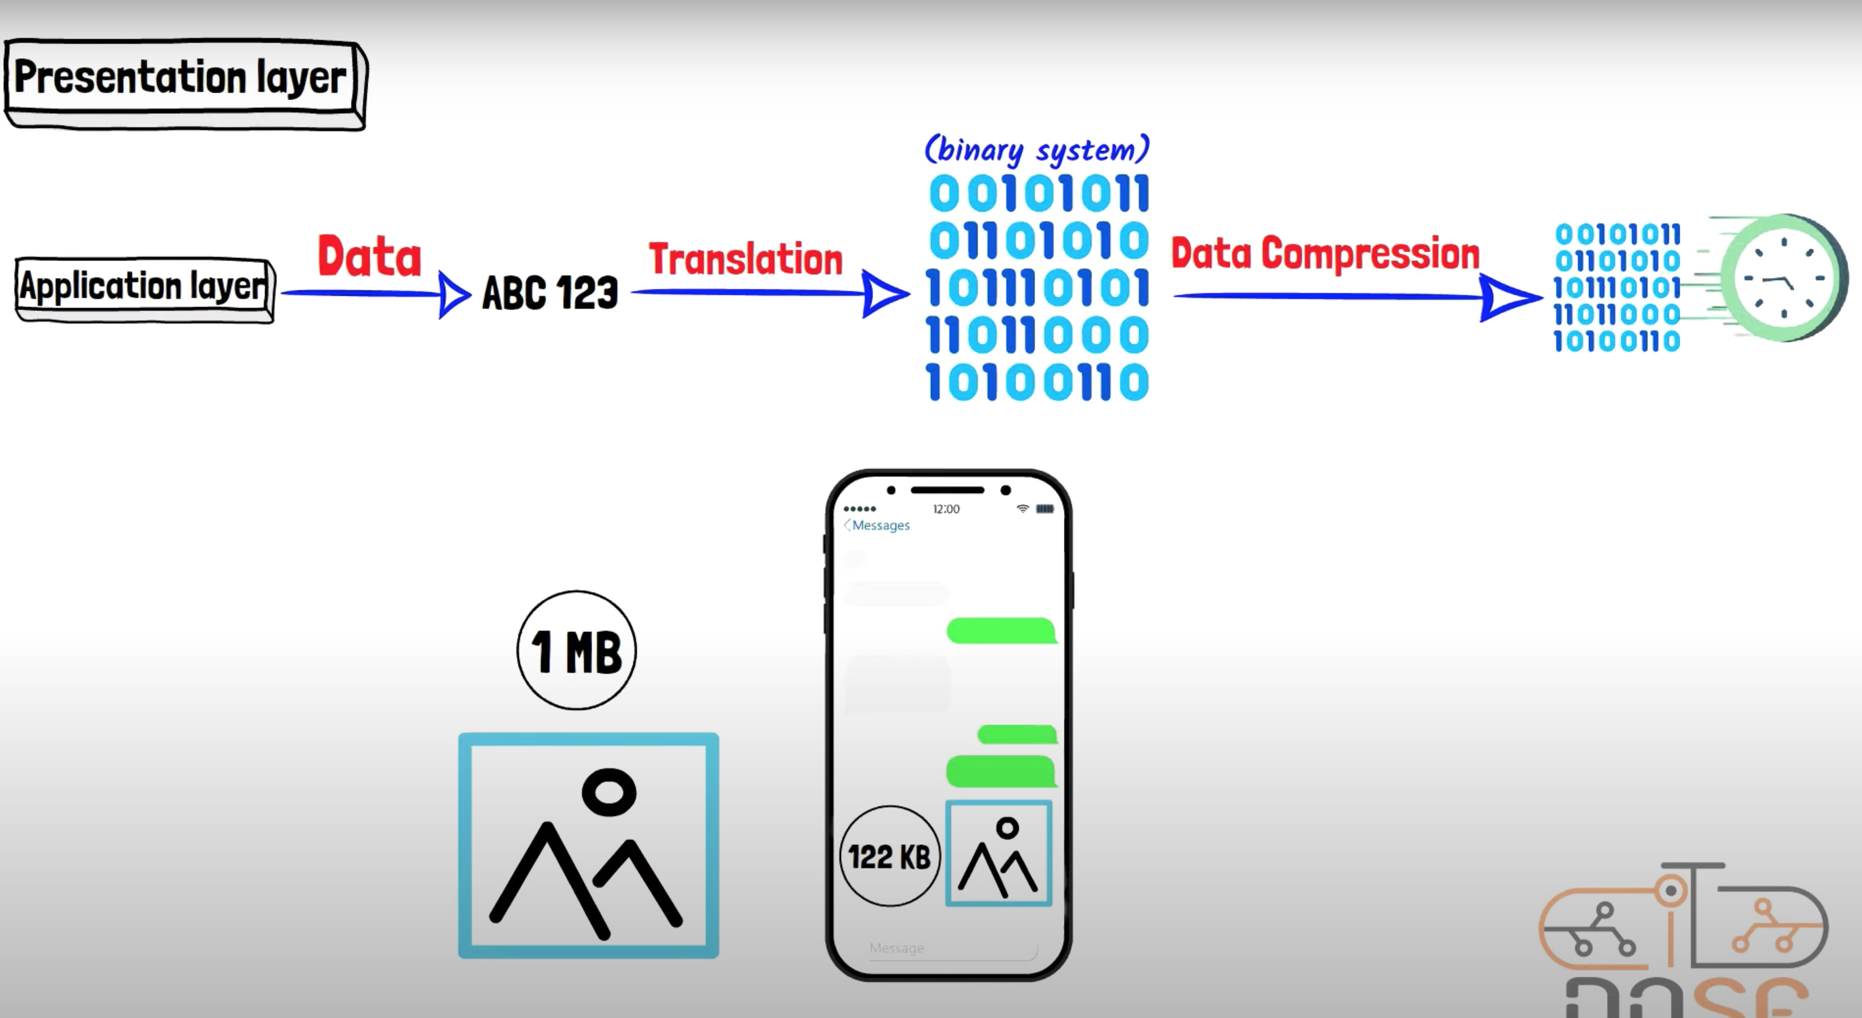
Layer 6 – Presentation Layer

Slide 24
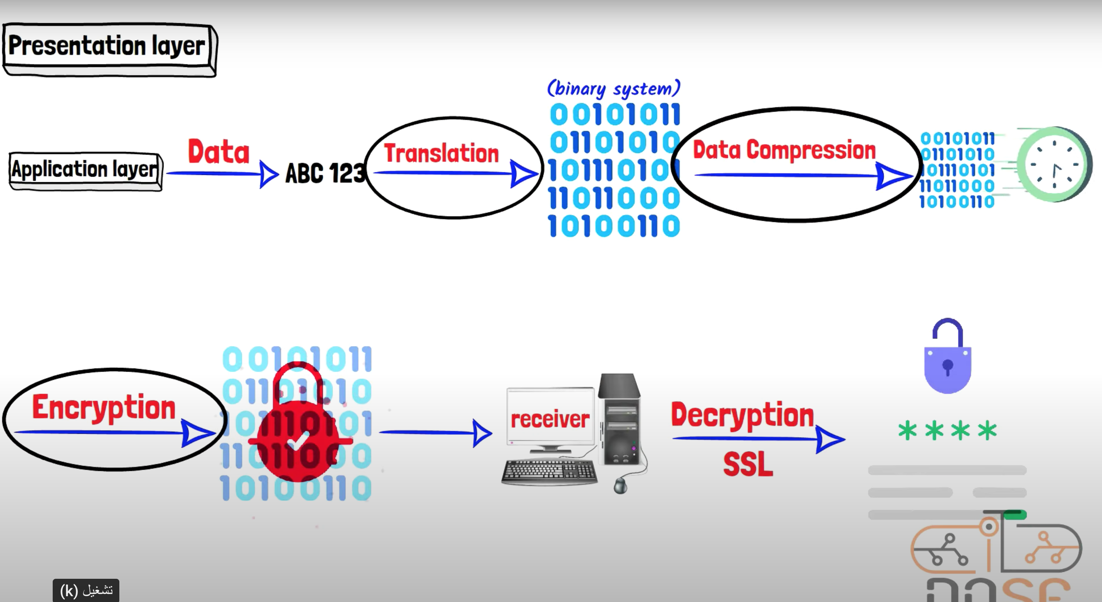
Layer 6 – Presentation Layer

Slide 25
Layer 6 – Presentation Layer
This layer translates the data format from sender to receiver in the various OSes that may be used.
It is responsible for data encryption, compression, and conversion between different data formats.

Slide 26
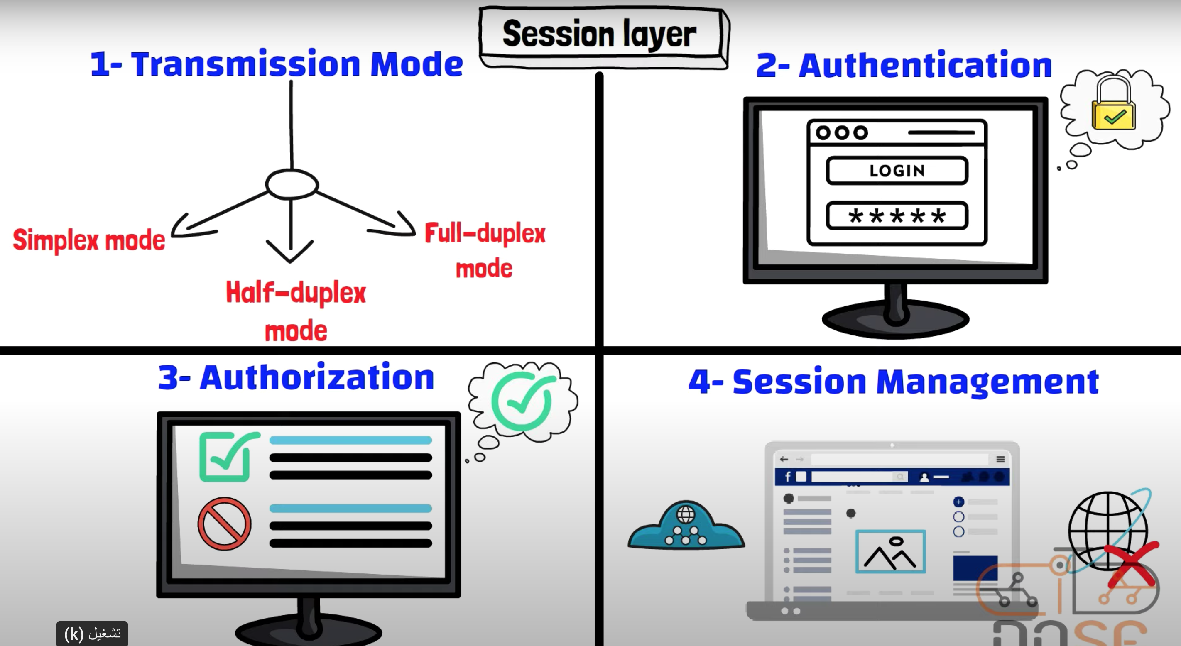
Layer 5 – Session Layer

Slide 27
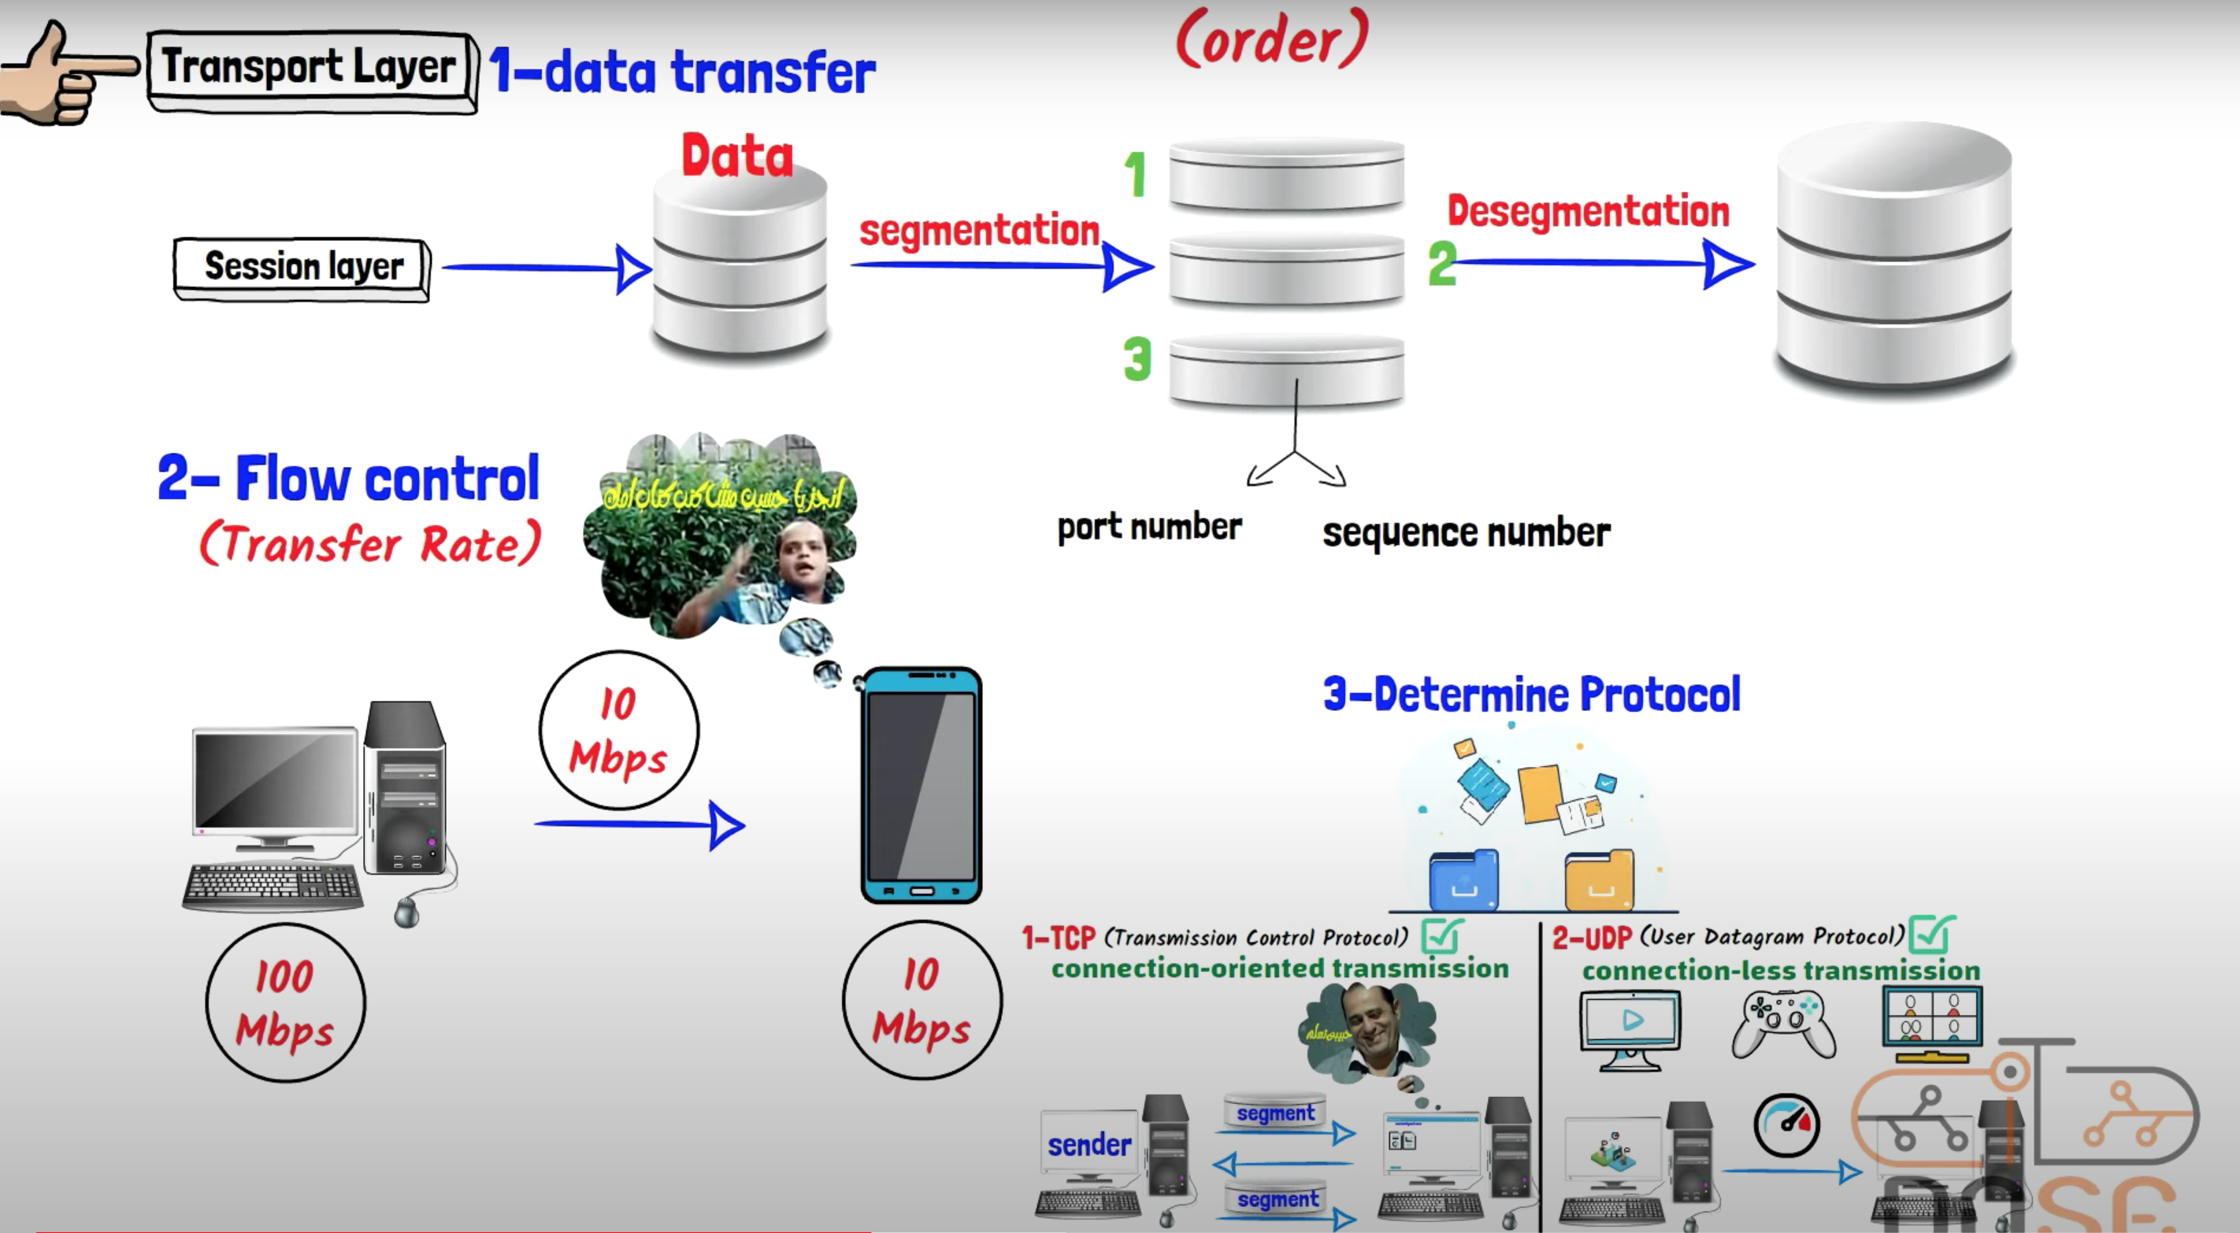
Layer 4 – Transport Layer

Slide 28
Layer 4 – Transport Layer
Transport Layer: The transport layer ensures reliable end-to-end communication between host devices.
It provides mechanisms for segmenting data from the upper layers into smaller units, reassembling them on the receiving end, and handling flow control, error recovery, and congestion control.
The Transport Layer contains both connection-oriented and connectionless protocols.
Unit of measurement used: segments or messages

Slide 29
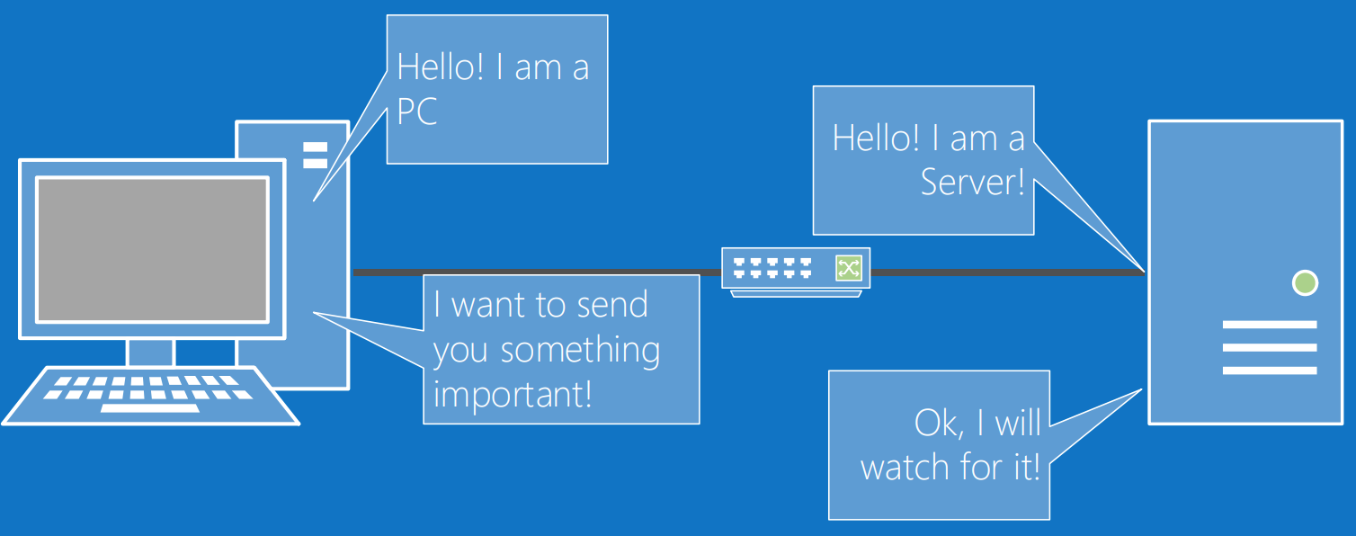
Connection Oriented Communications
Connection-oriented communication refers to a reliable and structured method of data transfer that establishes a dedicated connection between sender and receiver before transmitting data. It ensures ordered delivery and provides error detection and correction mechanisms.

Slide 30
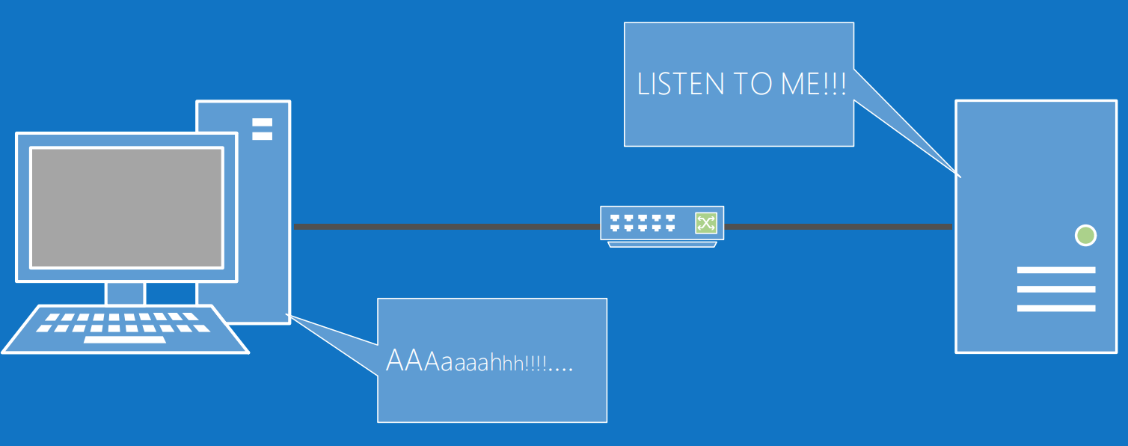
Connectionless Communications
Connectionless communication is a direct and straightforward method of data transfer where data packets are sent independently without establishing a dedicated connection. It does not guarantee reliable delivery or maintain packet order.

Slide 31
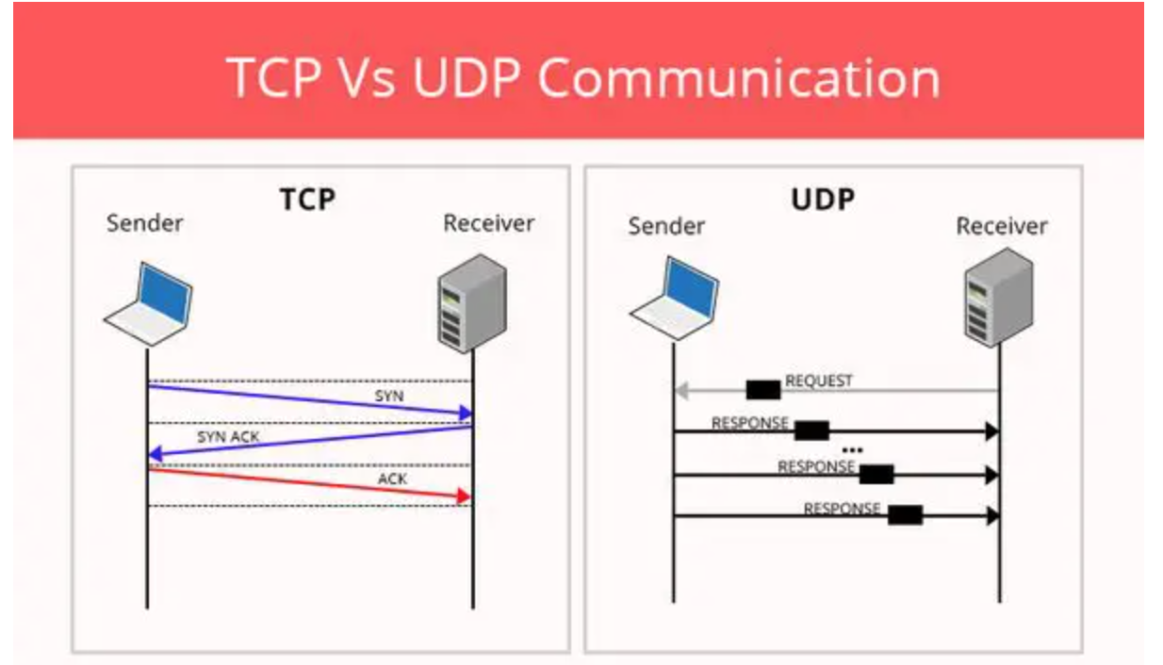
Connection-based Protocols
The Transport Layer contains both connection-oriented and connectionless protocols.
Transmission Control Protocol (TCP) provides a connection-based, reliable, byte-stream service to programs.
User Datagram Protocol (UDP) provides a connectionless, unreliable transport service.

Slide 32
Ports
Ports are a Layer 4 protocol that a computer uses for data transmission.
Ports act as logical communications endpoint for specific program on computers for delivery of data sent.
There are a total of 65,536 ports, numbering between 0 and 65,535

Slide 33
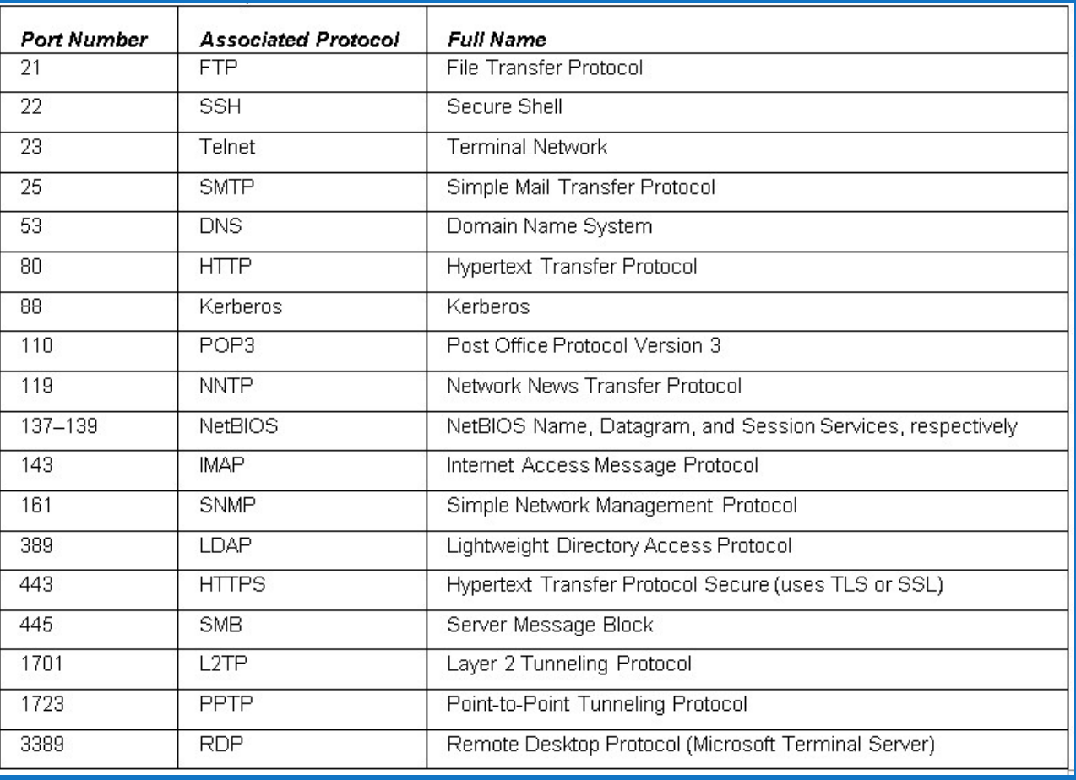
Ports

Slide 34
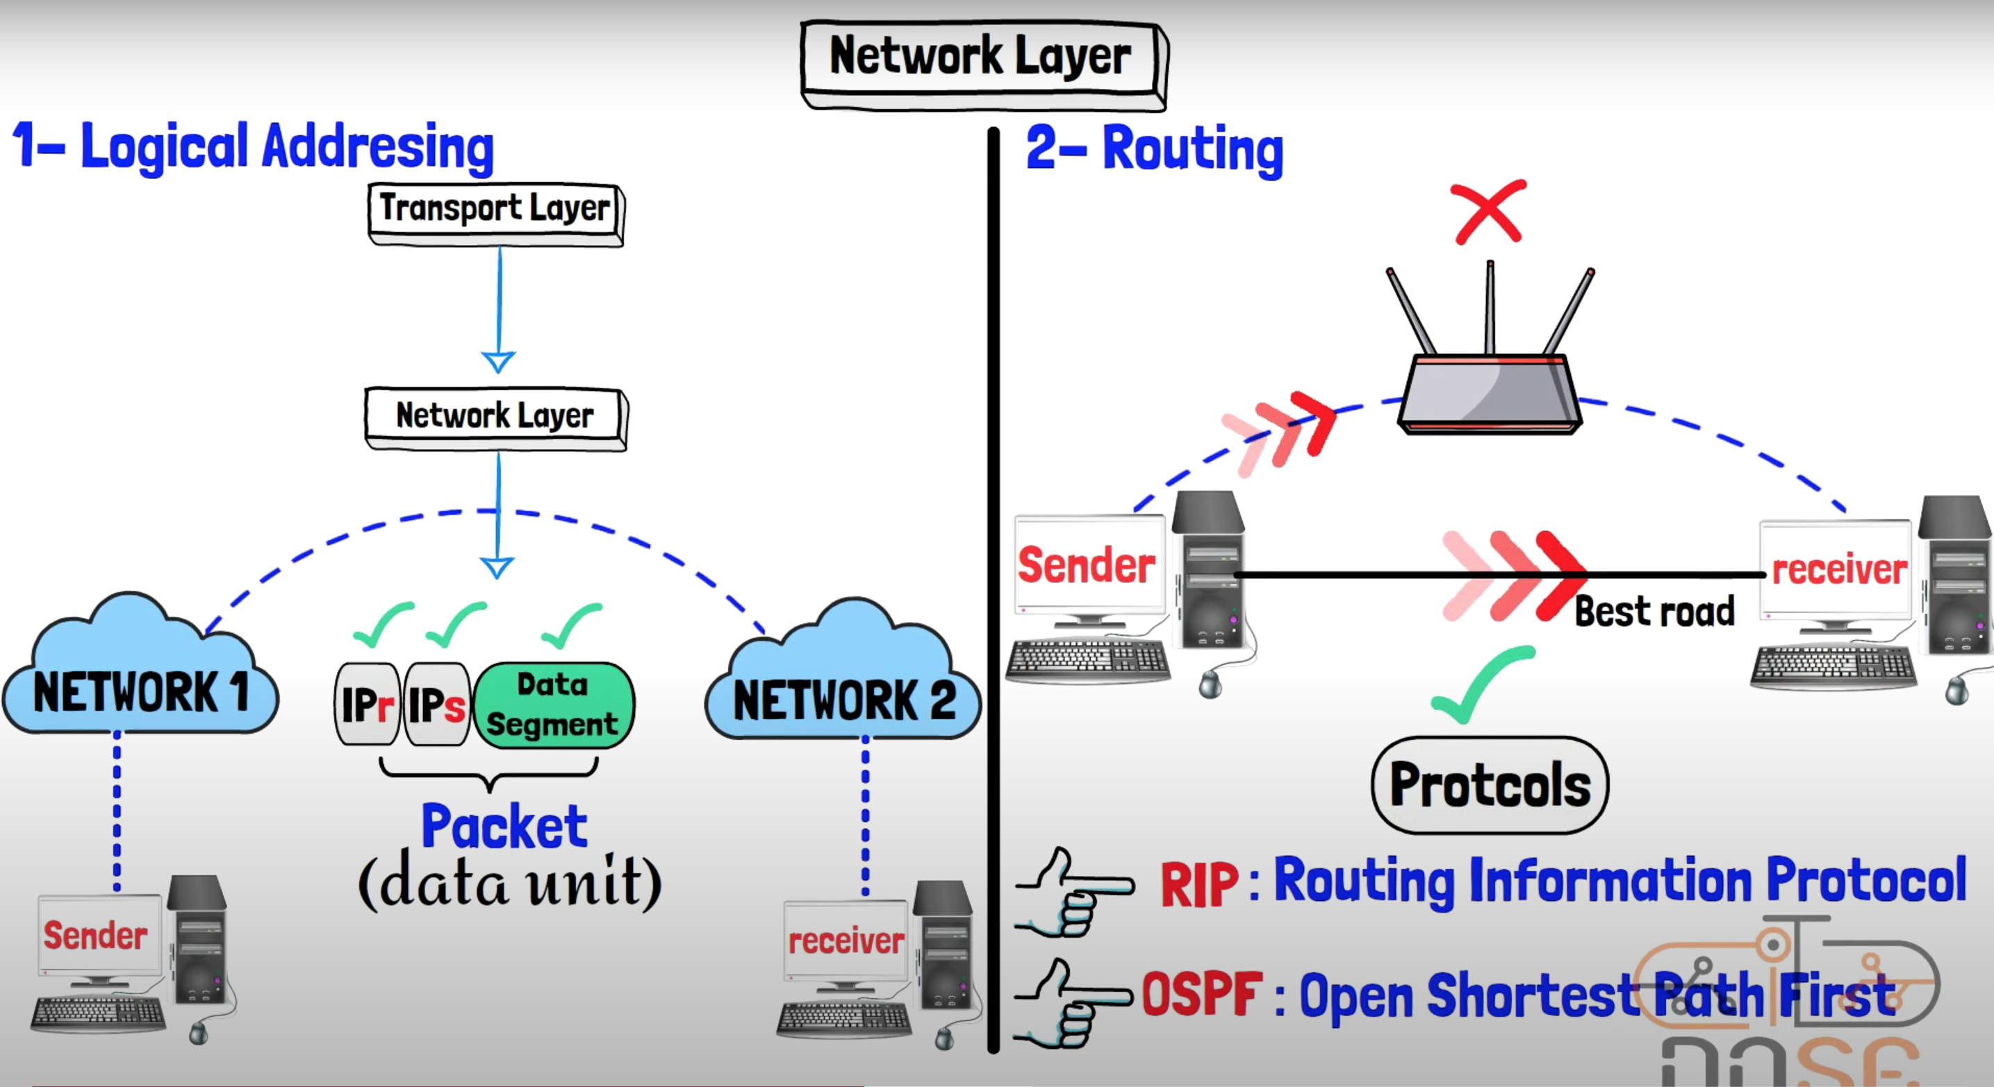
Layer 4 – Network Layer

Slide 35
Layer 4 – Network Layer
Network Layer: The network layer is responsible for the logical addressing and routing of data packets across multiple networks.
It determines the optimal path for data transmission from the source to the destination based on network conditions, addressing schemes, and routing protocols. IP (Internet Protocol) is a widely used network layer protocol.
Devices that work at the network layer are routers and IP switches L 3 .
Network Layer components: IP addresses, subnets.
Unit of measurement: packets.

Slide 36
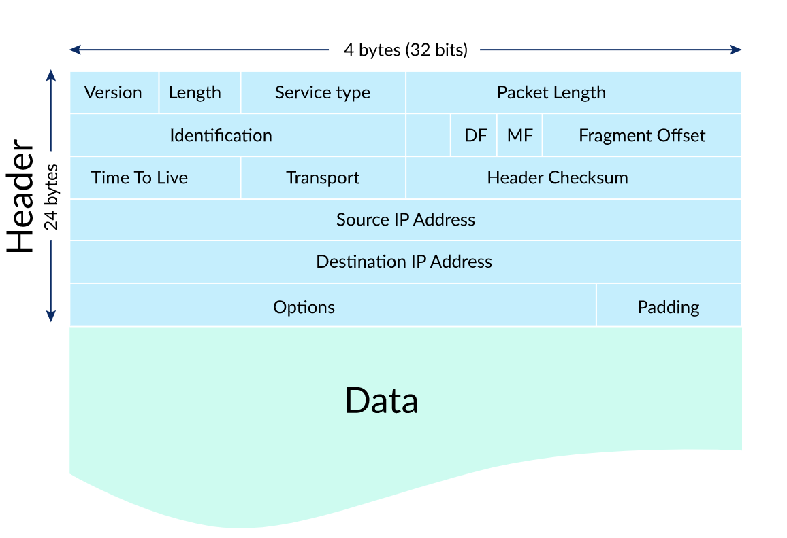
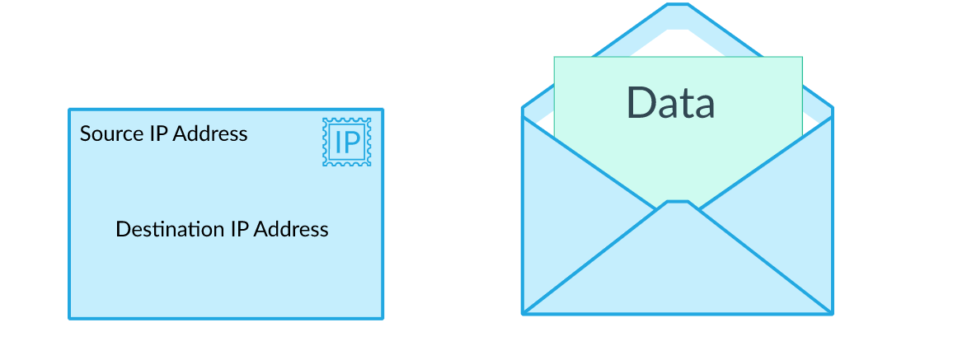
what is packets
Packets are small units of data that are used for transmitting information over a network. In computer networking, data is divided into packets for efficient and reliable transmission. Each packet contains a portion of the data being sent, along with specific header information that includes source and destination addresses, error detection codes, and other necessary control information.

Slide 37
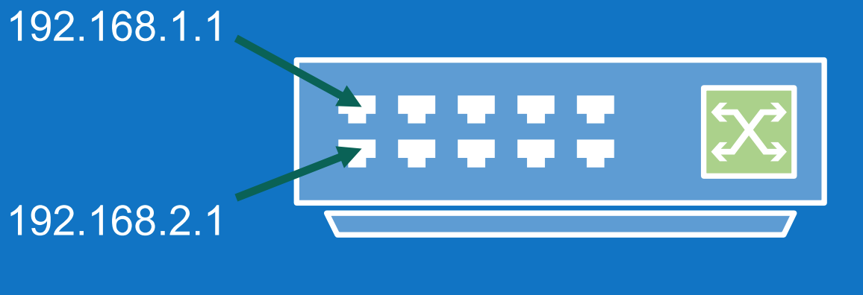
Layer 3 Switches
Switches can also reside on the network layer.
A layer 3 switch determines paths for data using logical addressing (IP addresses) instead of physical addressing (MAC addresses for a layer 2 switch).
Layer 3 switches forward packets, whereas layer 2 switches forward frames

Slide 38
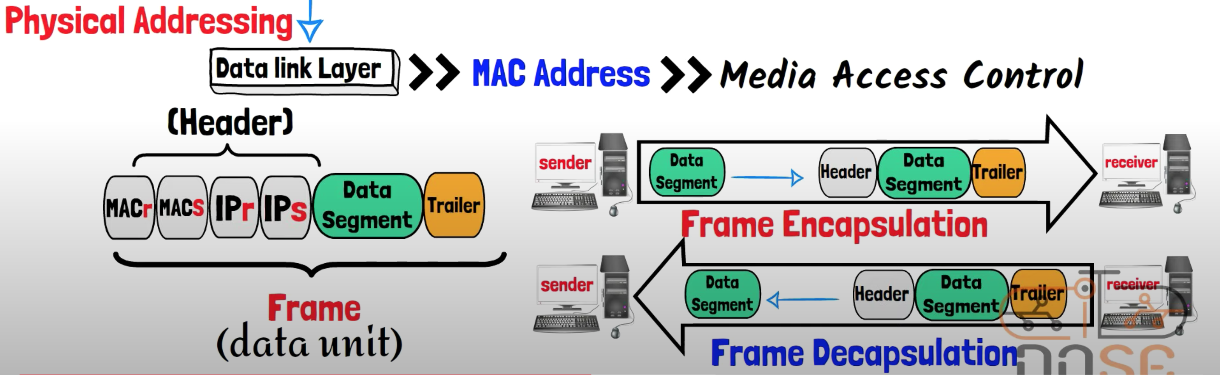
Layer 2 – Data Link Layer

Slide 39
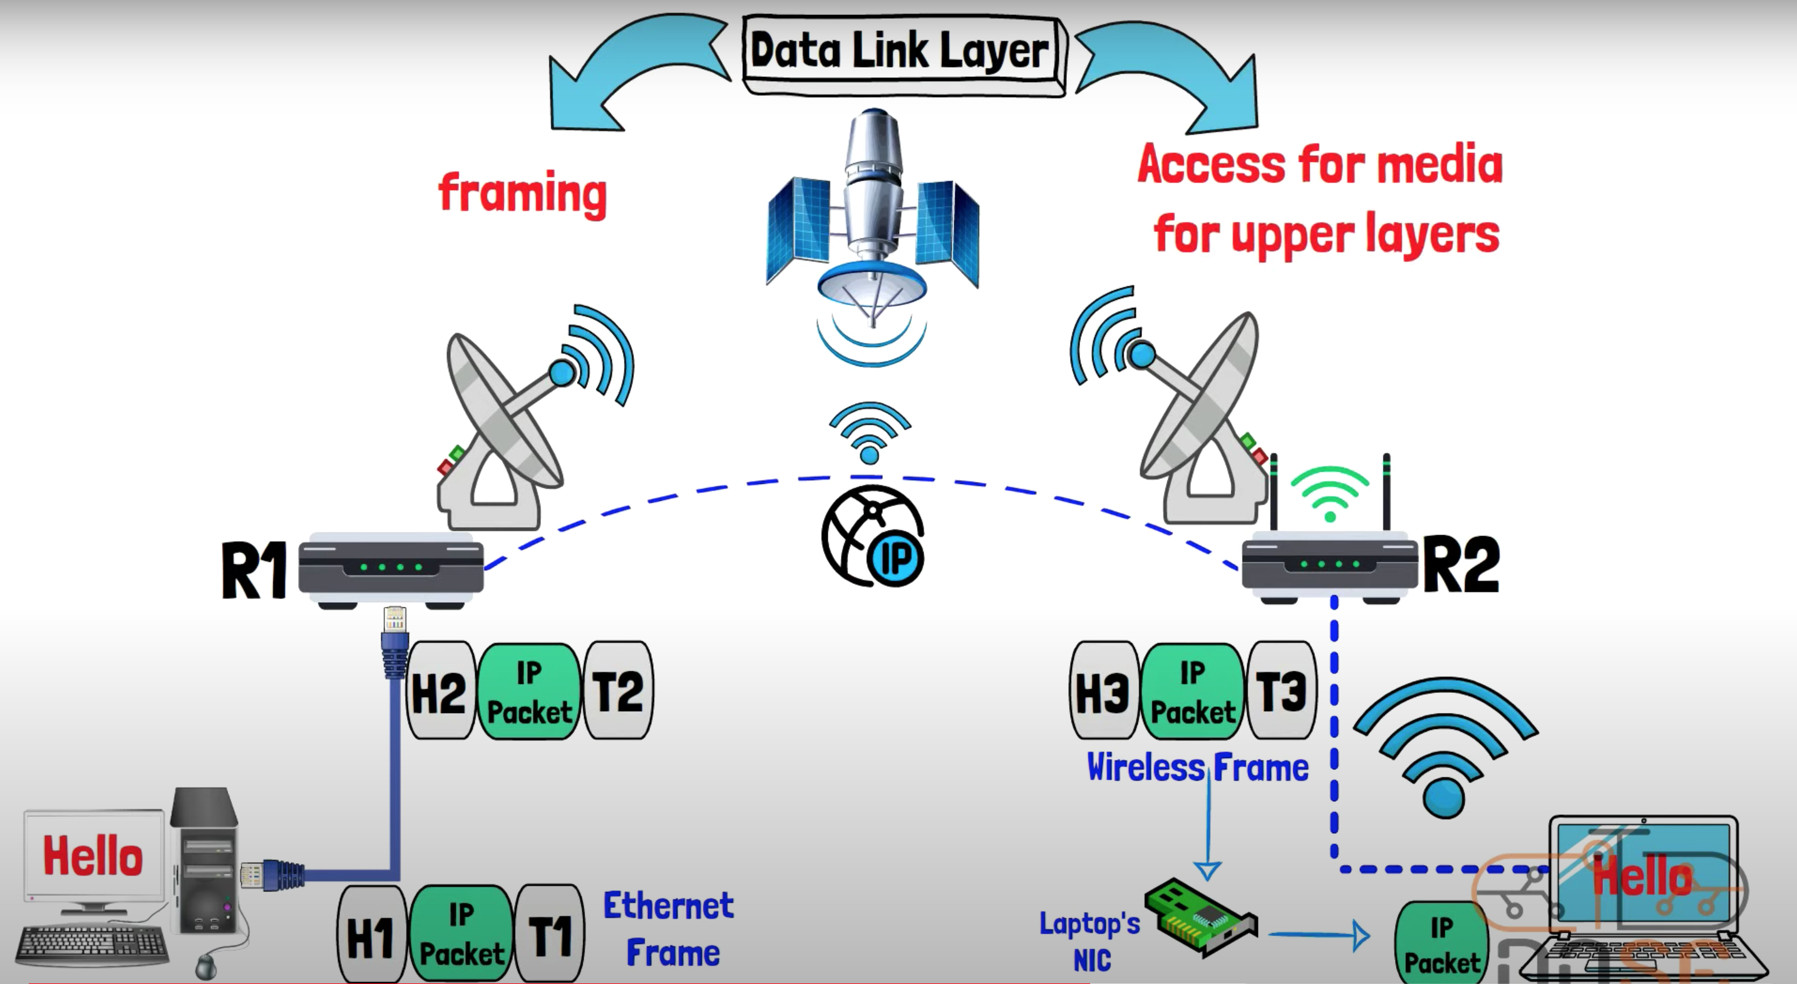
Layer 2 – Data Link Layer

Slide 40
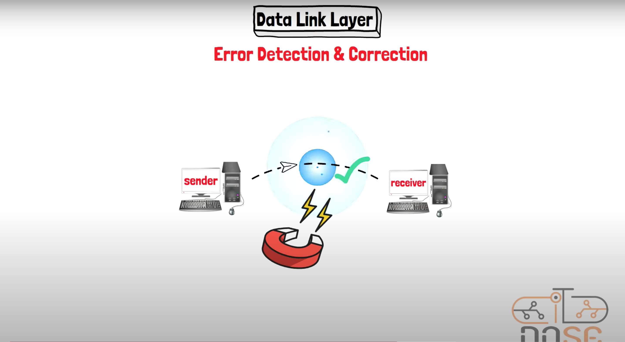
Layer 2 – Data Link Layer

Slide 41
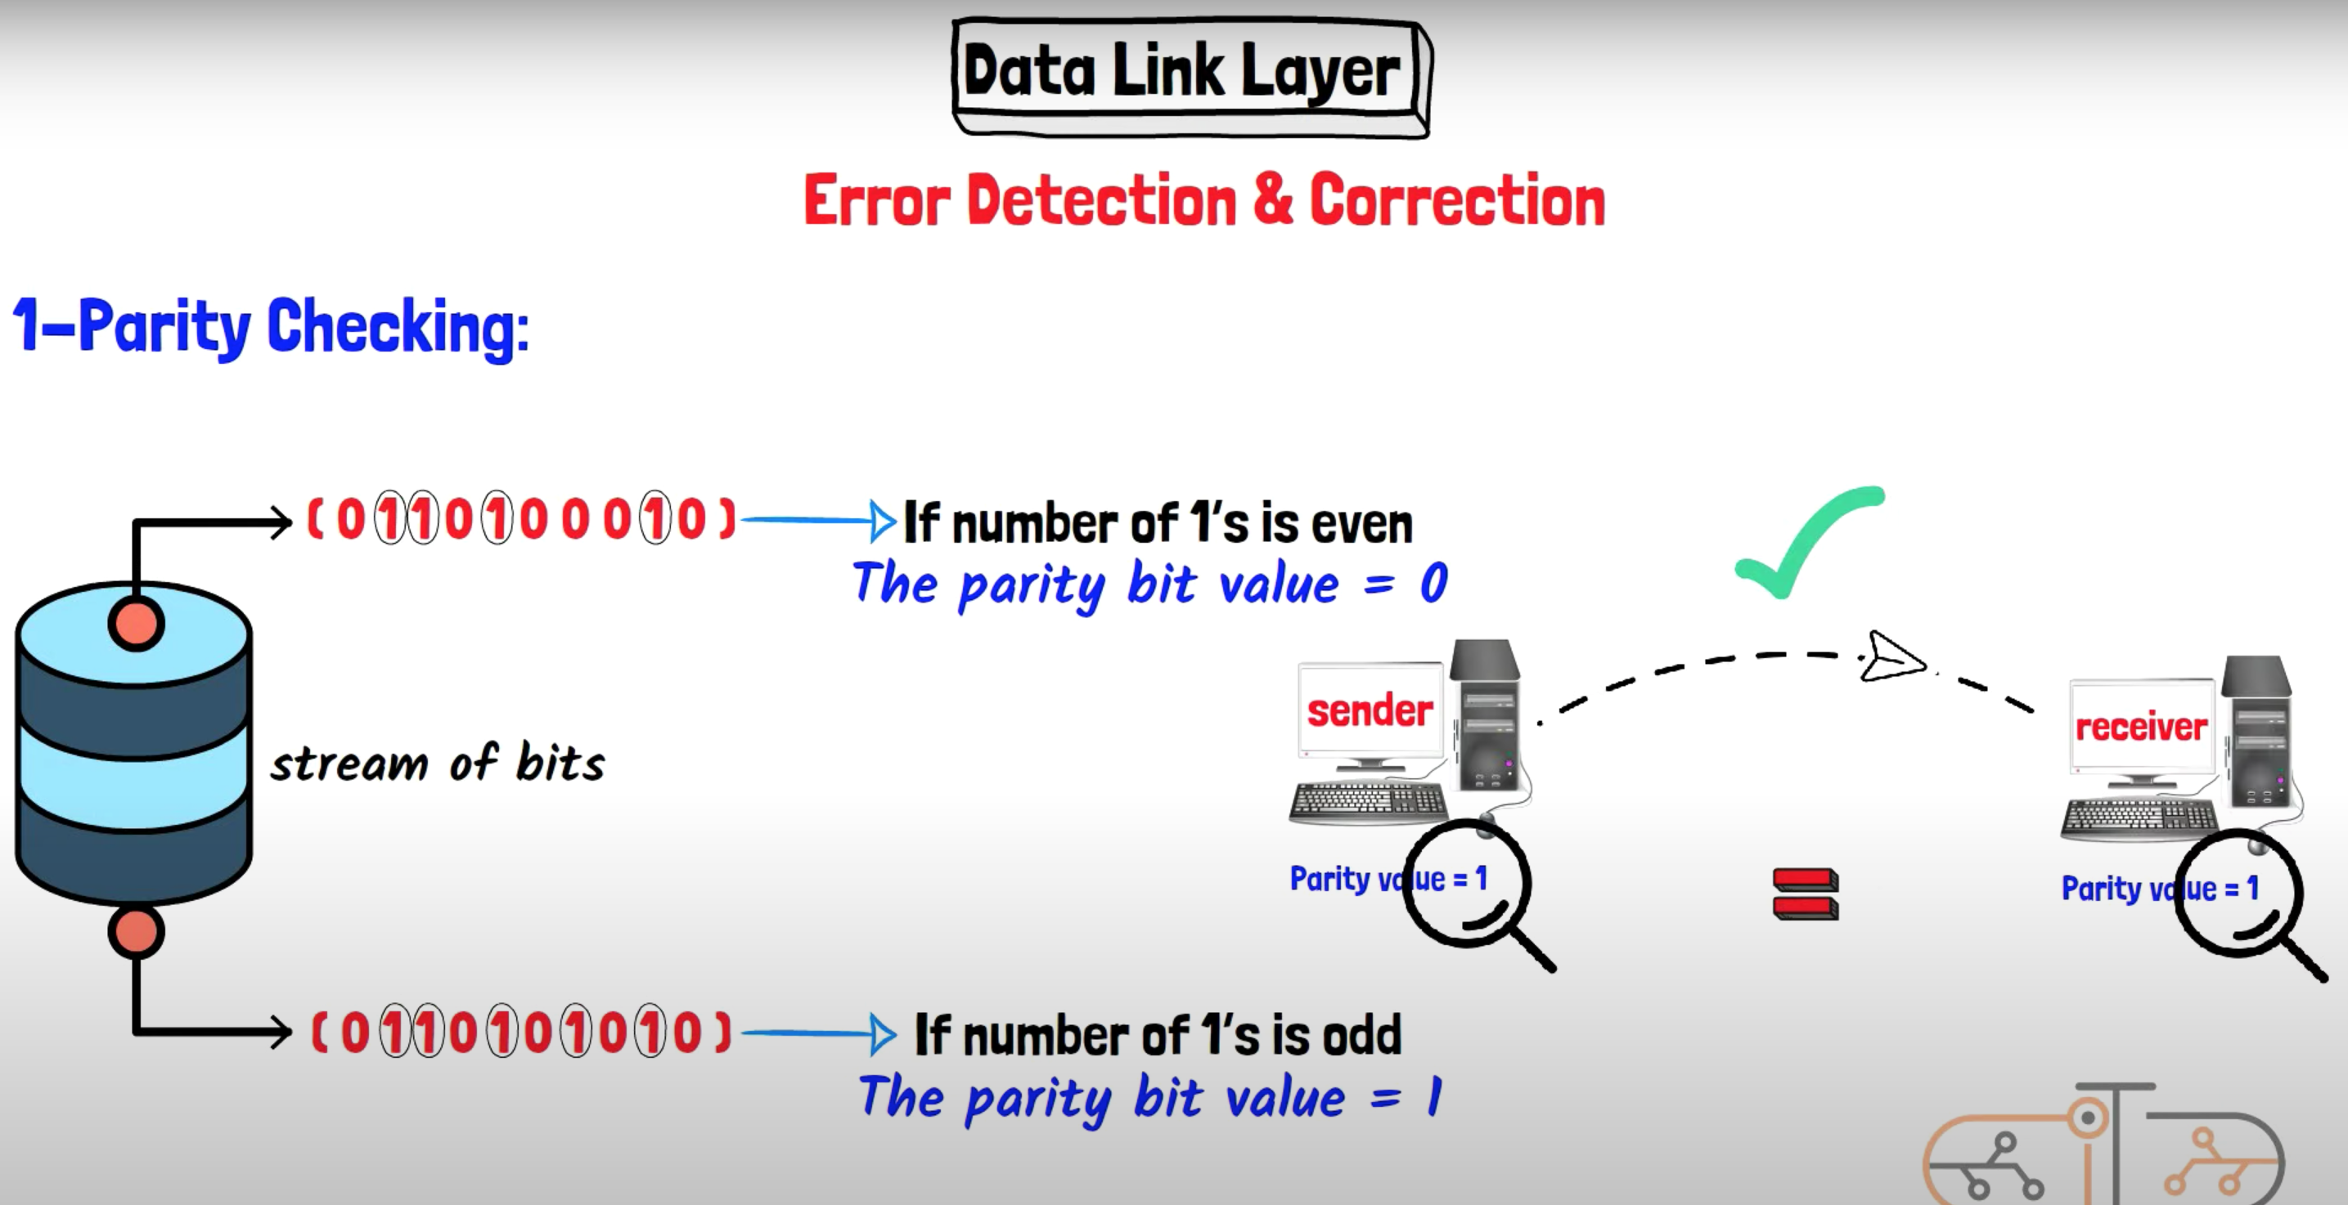
Layer 2 – Data Link Layer

Slide 42
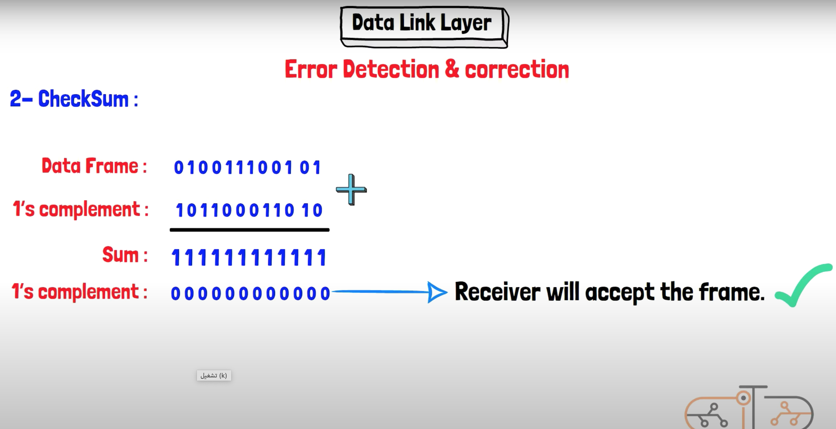
Layer 2 – Data Link Layer

Slide 43
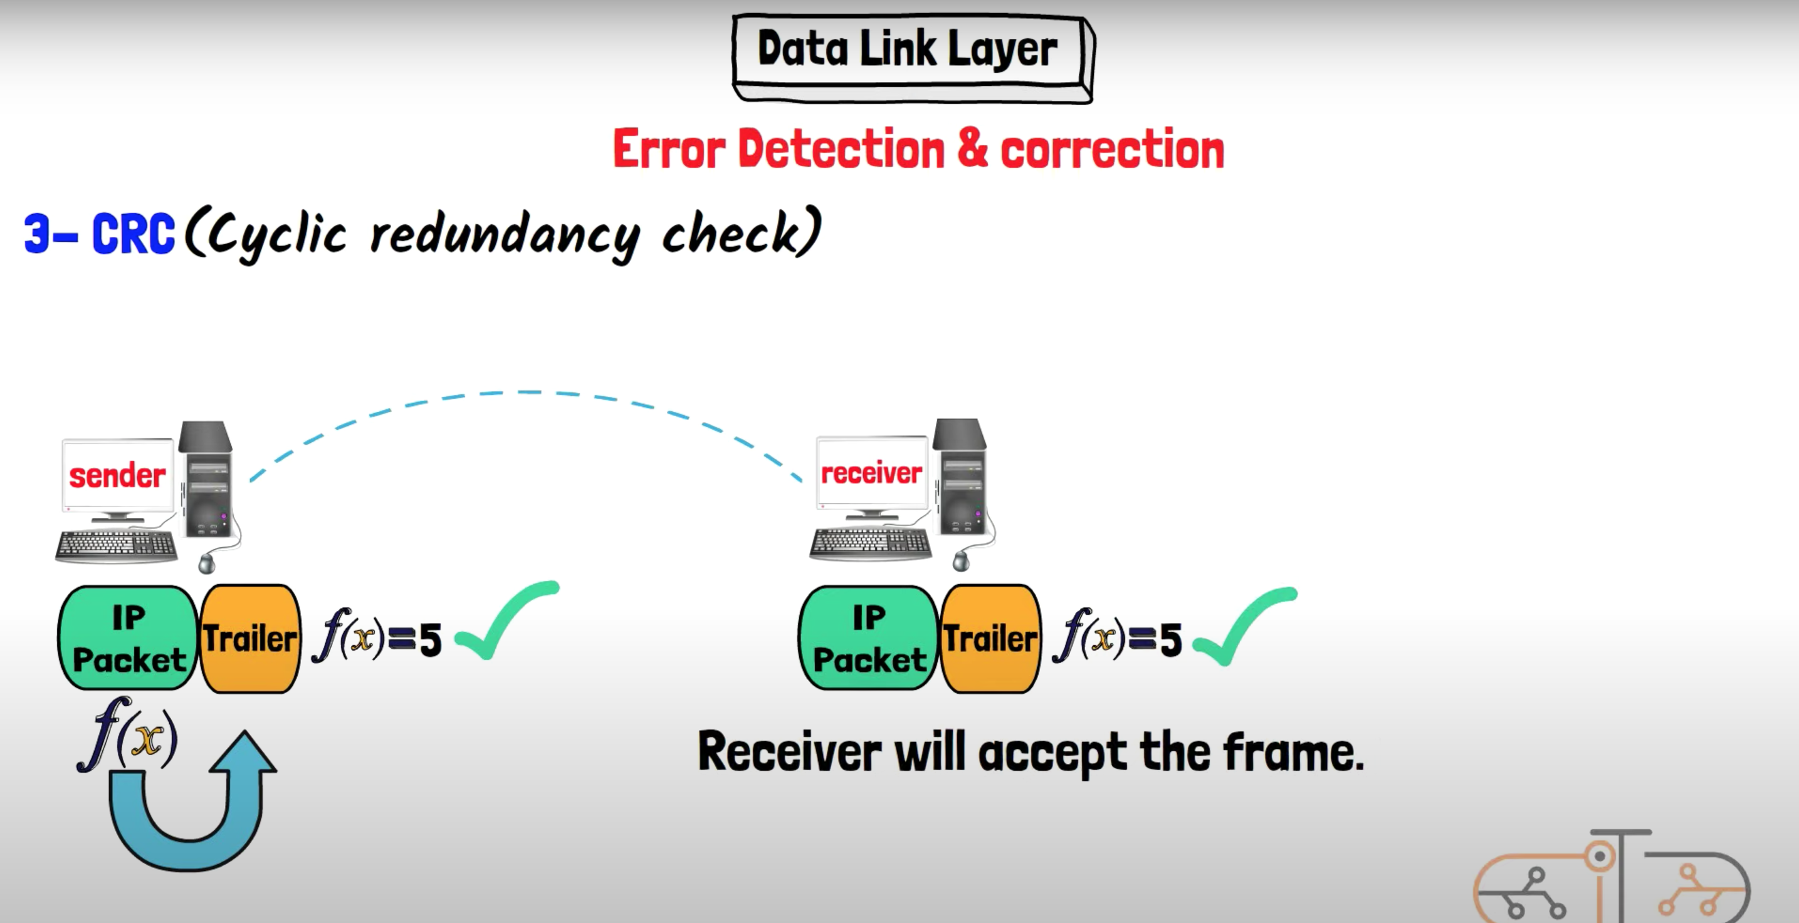
Layer 2 – Data Link Layer

Slide 44
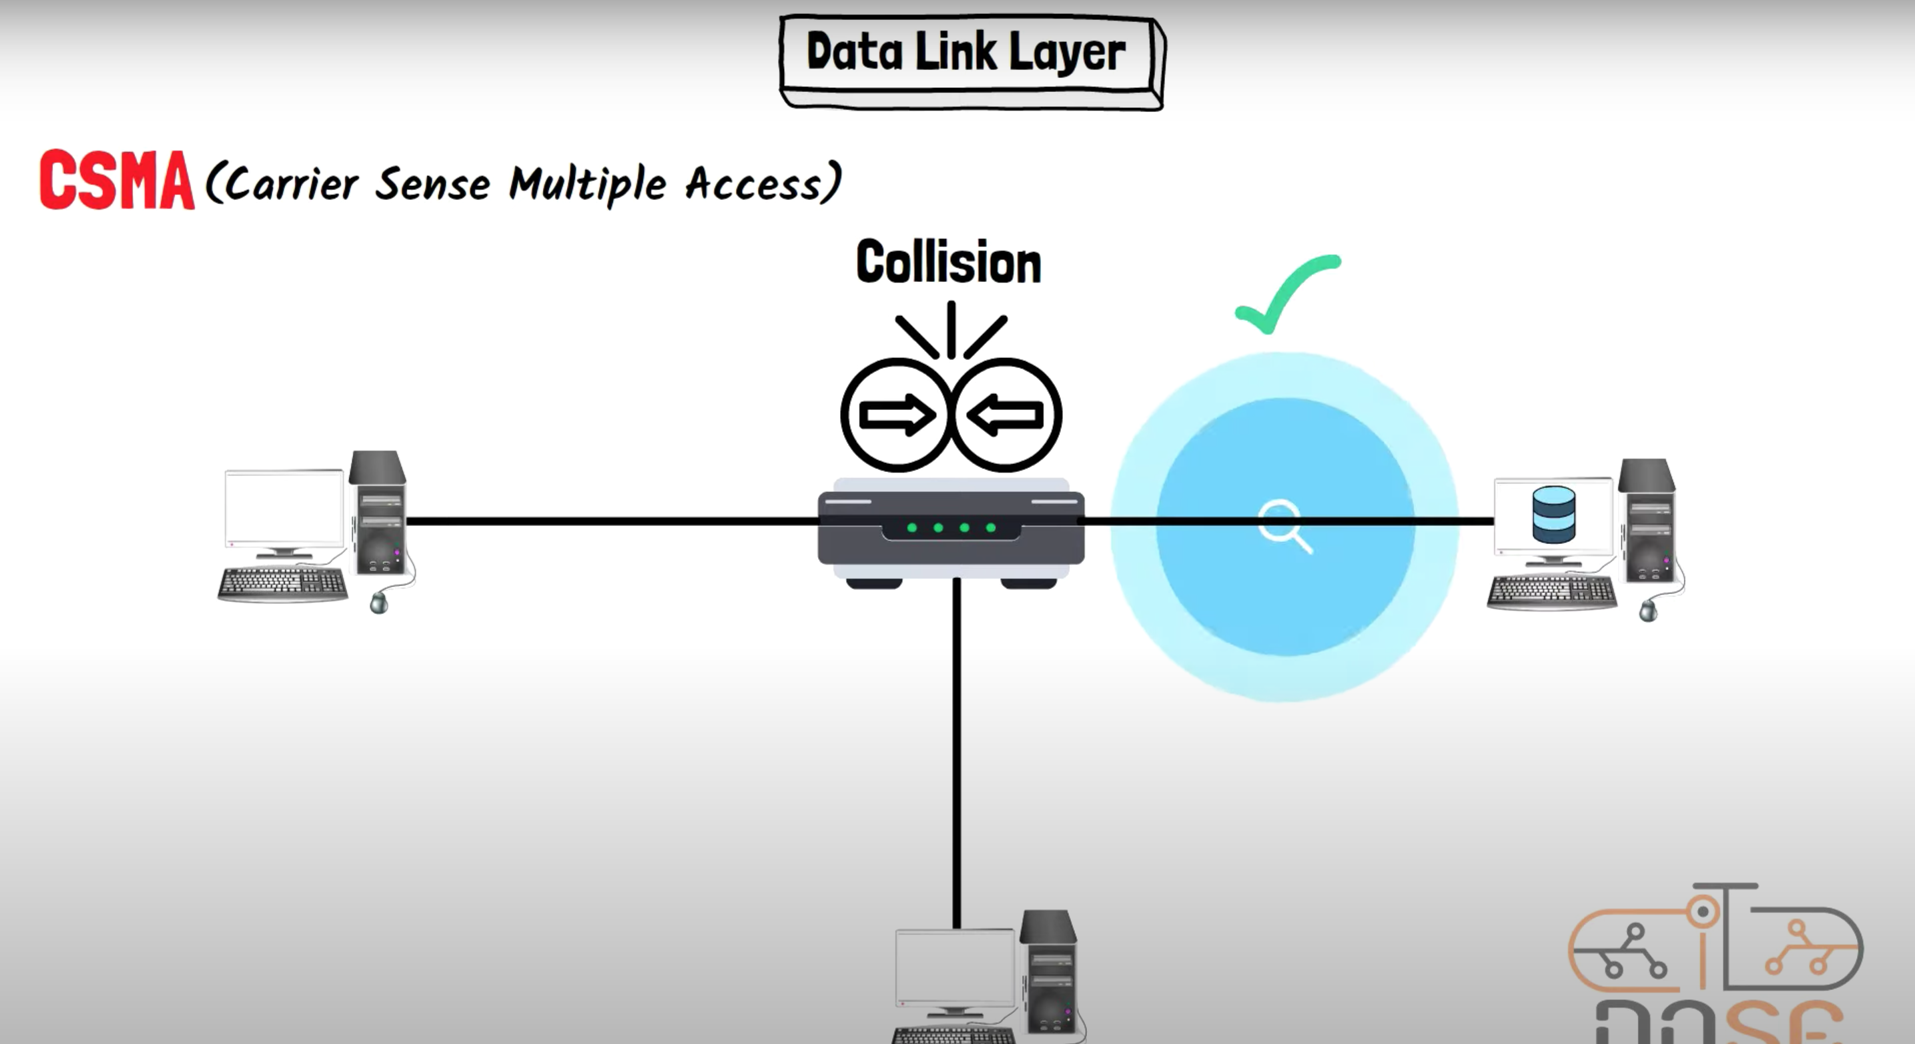
Layer 2 – Data Link Layer

Slide 45
Layer 2 – Data Link Layer
Data Link Layer: The data link layer provides error-free transmission of data frames between two nodes on the same network segment.
It is responsible for framing, error detection and correction, flow control, and access control to the physical media. Ethernet and Wi-Fi are examples of protocols that operate at this layer.

Slide 46
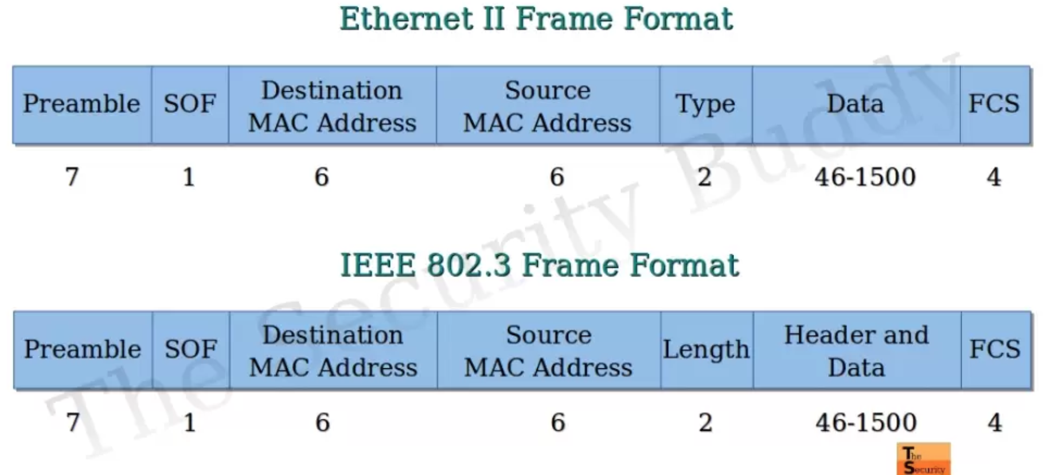
what is Frames
Frames in a network are structured units of data that contain information such as headers, data payload, and error detection codes. They are used to transmit data between devices in a network, ensuring reliable and organized delivery of information.

Slide 47
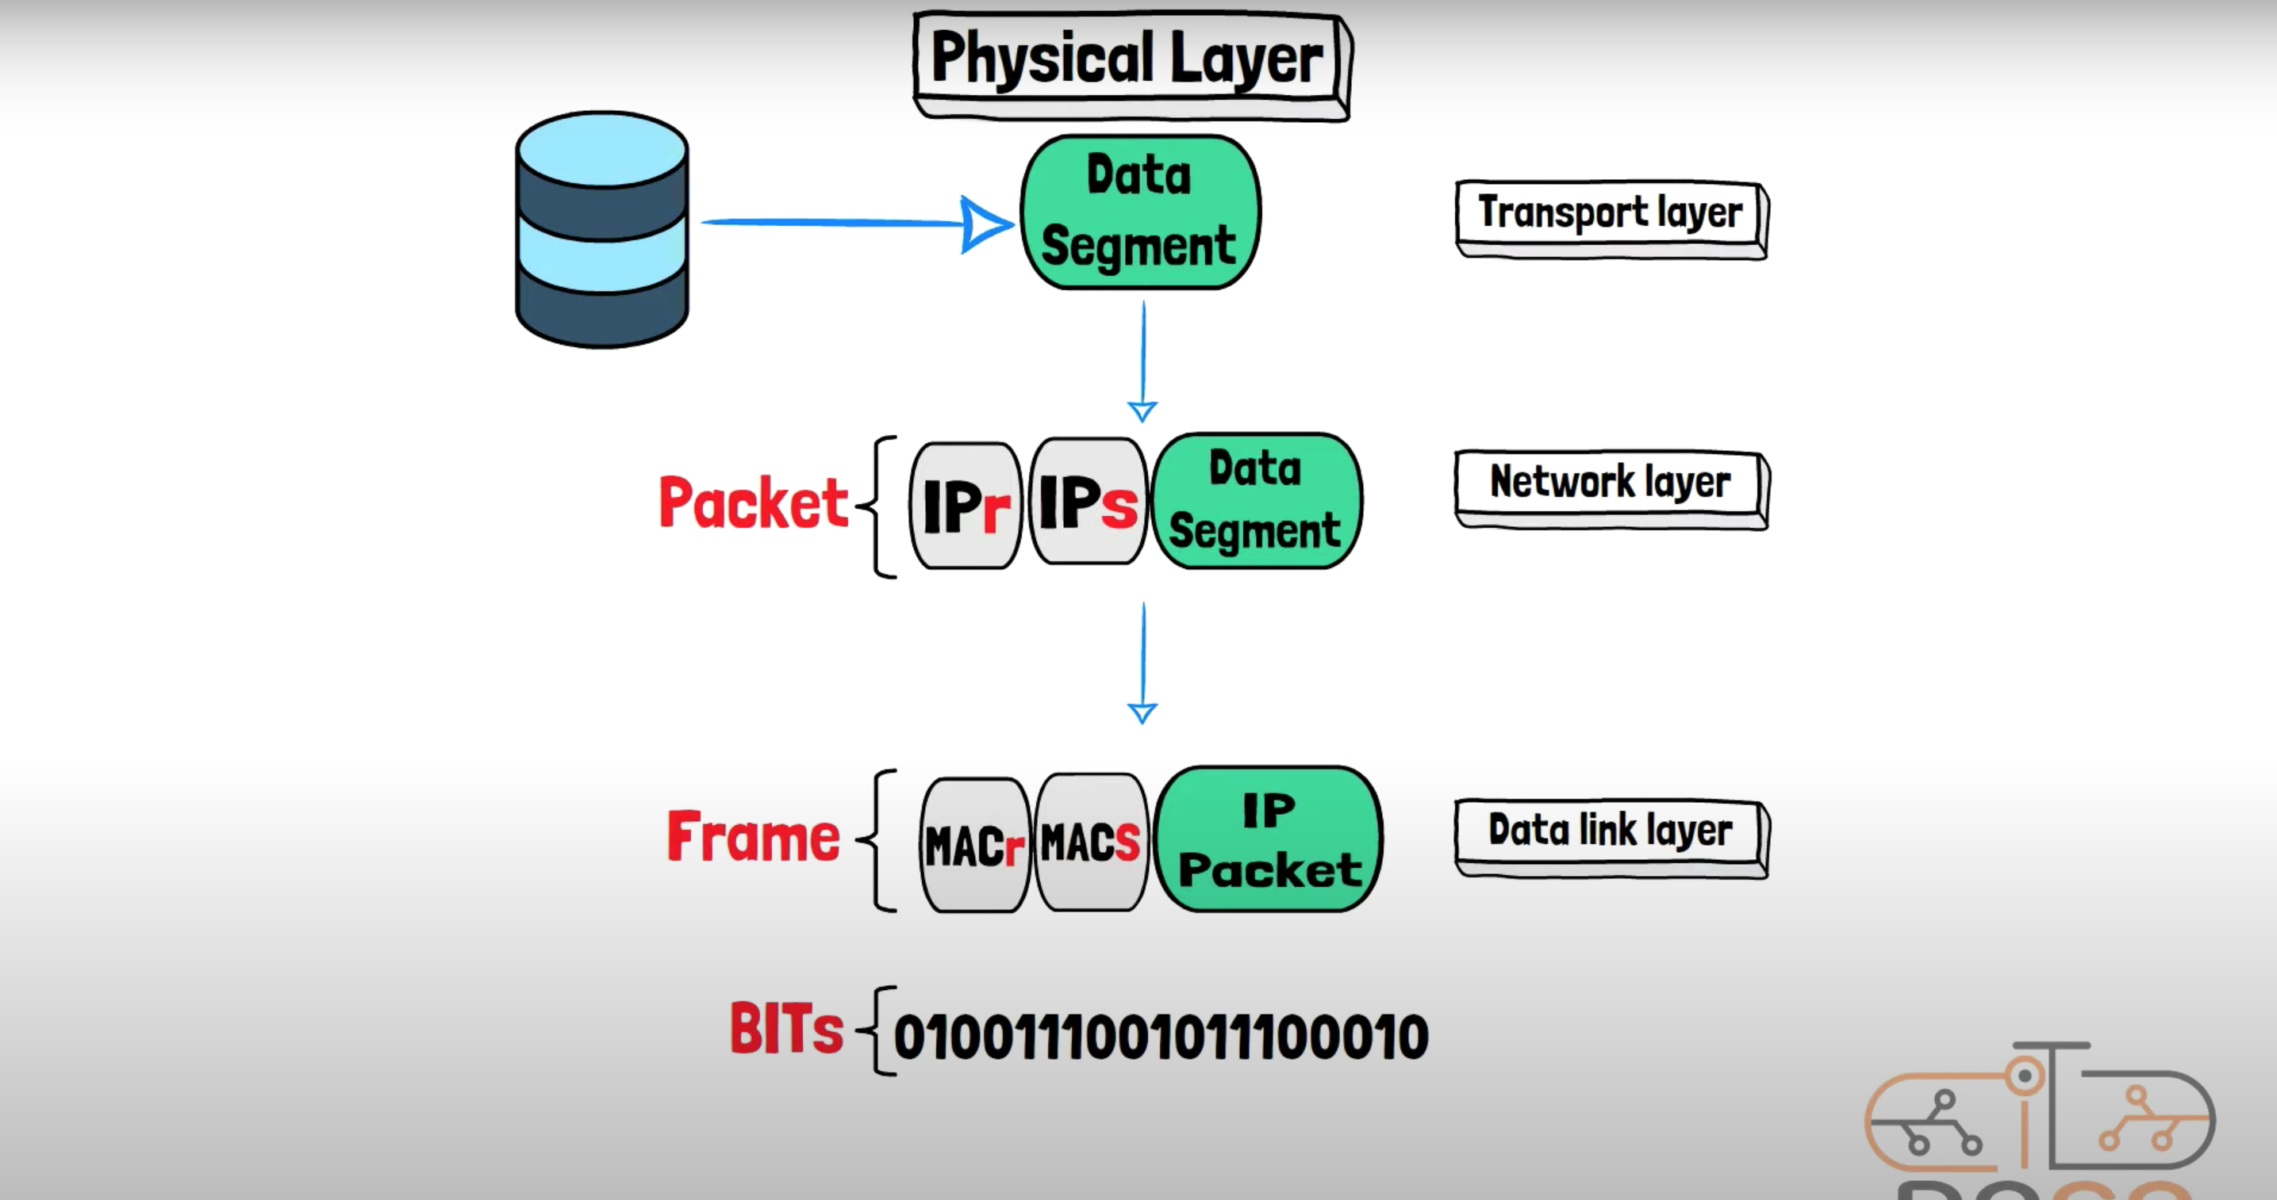
Layer 1 – Physical Layer

Slide 48
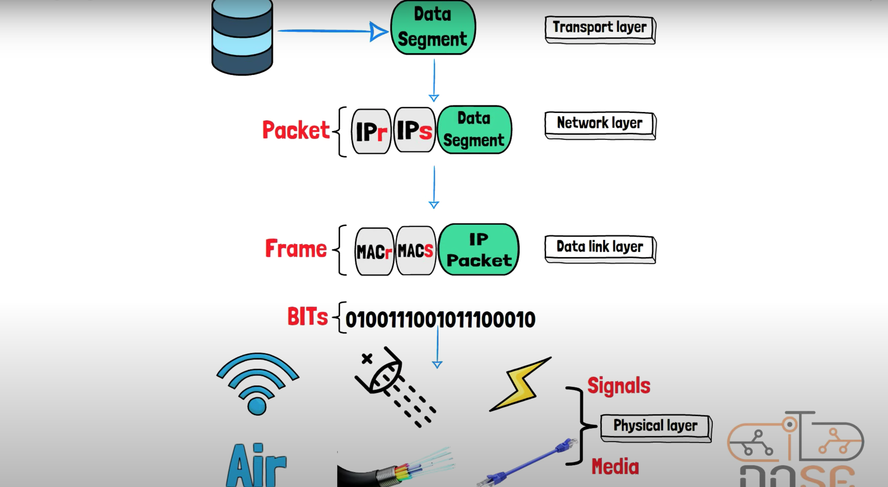
Layer 1 – Physical Layer

Slide 49
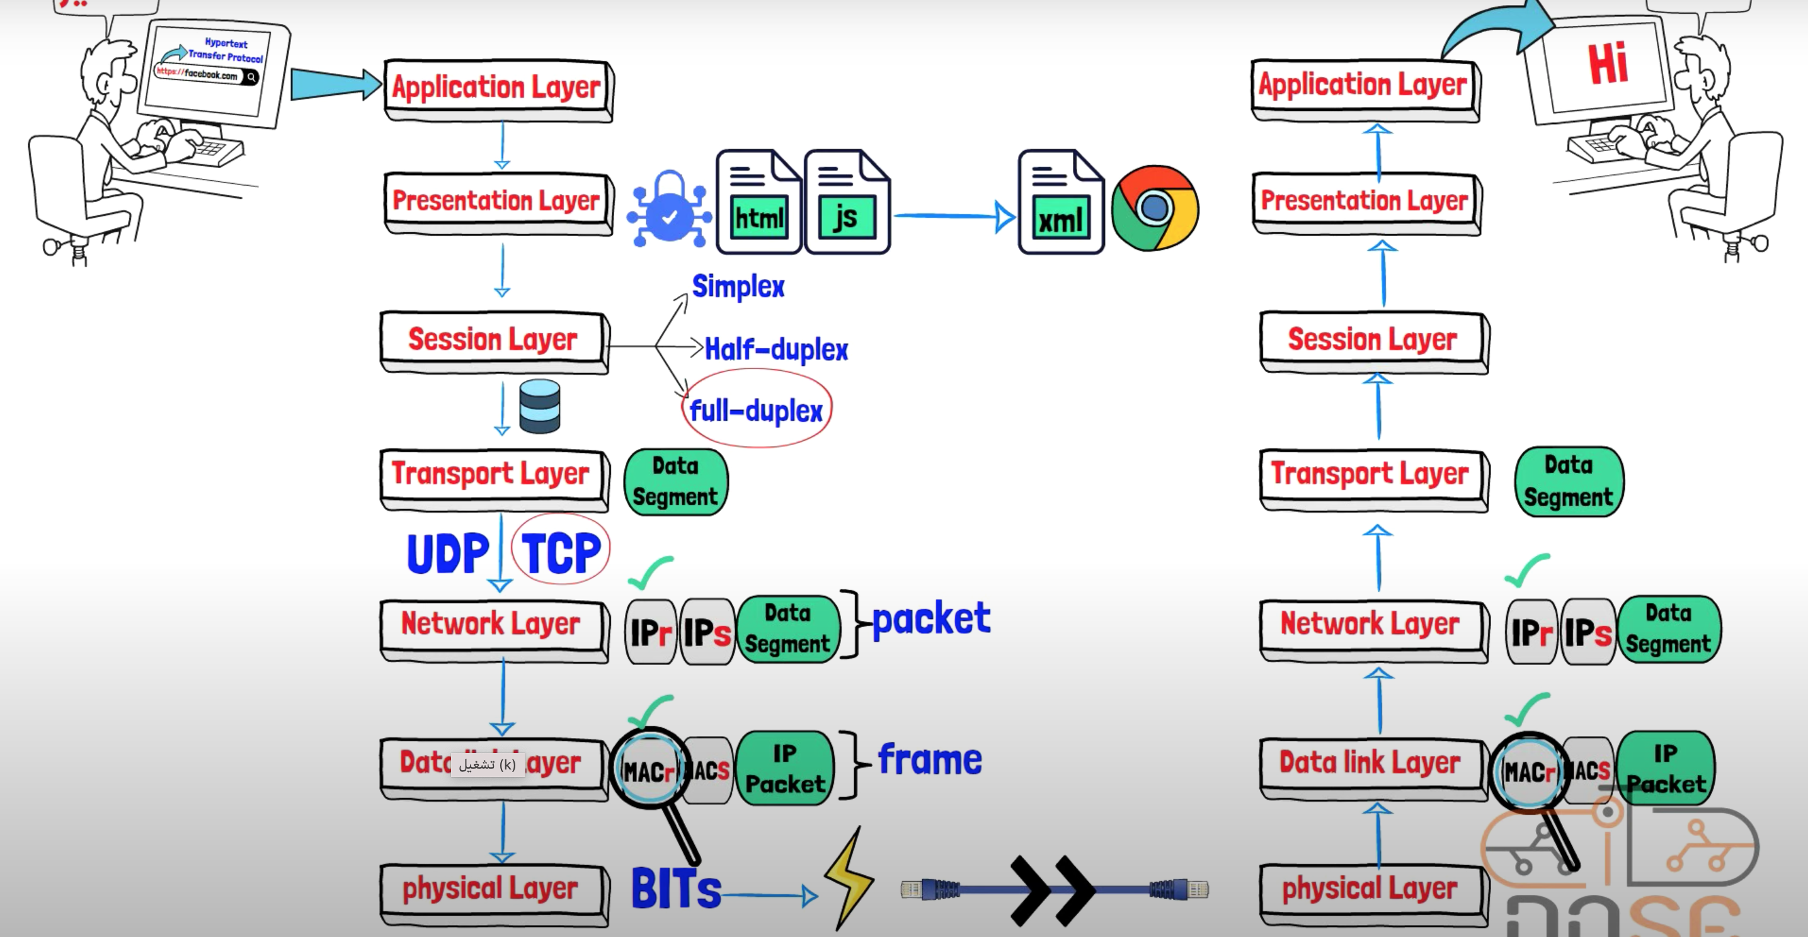

Slide 50
Layer 1 – Physical Layer
Physical Layer: This layer deals with the physical transmission of data over the network, including the electrical, mechanical, and physical specifications of the network interface, cables, and connectors. It defines the hardware aspects of network communication. For example, it specifies the voltage levels used for transmitting data.

